Slide 2
Preparation for the Last Days
Notes:
I know that this is “Family month”, but I felt led to continue with the last days for a few reasons:
Because our children are being confronted with the behavior of people in the last days
Because our marriages are breaking up due to selfishness, pride, etc.

Slide 3
Today I want to deal with the last in the list of 19 characteristics of people in the last days:

Slide 4
2Ti 3:5 - …having a form of godliness but denying its power. And from such people turn away!

Slide 5
One of the clear signs of the last days is:

Slide 6
There will be those who look the part, but will not allow God to work in their lives

Slide 7
There will be those who talk the talk but do not walk the walk

Slide 8
Tit 1:15 - To the pure all things are pure, but to those who are defiled and unbelieving nothing is pure; but even their mind and conscience are defiled.

Slide 9
Tit 1:16 - They profess to know God, but in works they deny Him, being abominable, disobedient, and disqualified for every good work.

Slide 10
This is what we call “religious hypocrisy”, which includes:

Slide 11
#1 – Carnal Christians (under the influences of fleshly appetites)

Slide 12
1Co 3:1 - And I, brethren, could not speak to you as to spiritual people but as to carnal, as to babes in Christ.

Slide 13
1Co 3:2 - I fed you with milk and not with solid food; for until now you were not able to receive it, and even now you are still not able;

Slide 14
1Co 3:3 - for you are still carnal. For where there are envy, strife, and divisions among you, are you not carnal and behaving like mere men?

Slide 15
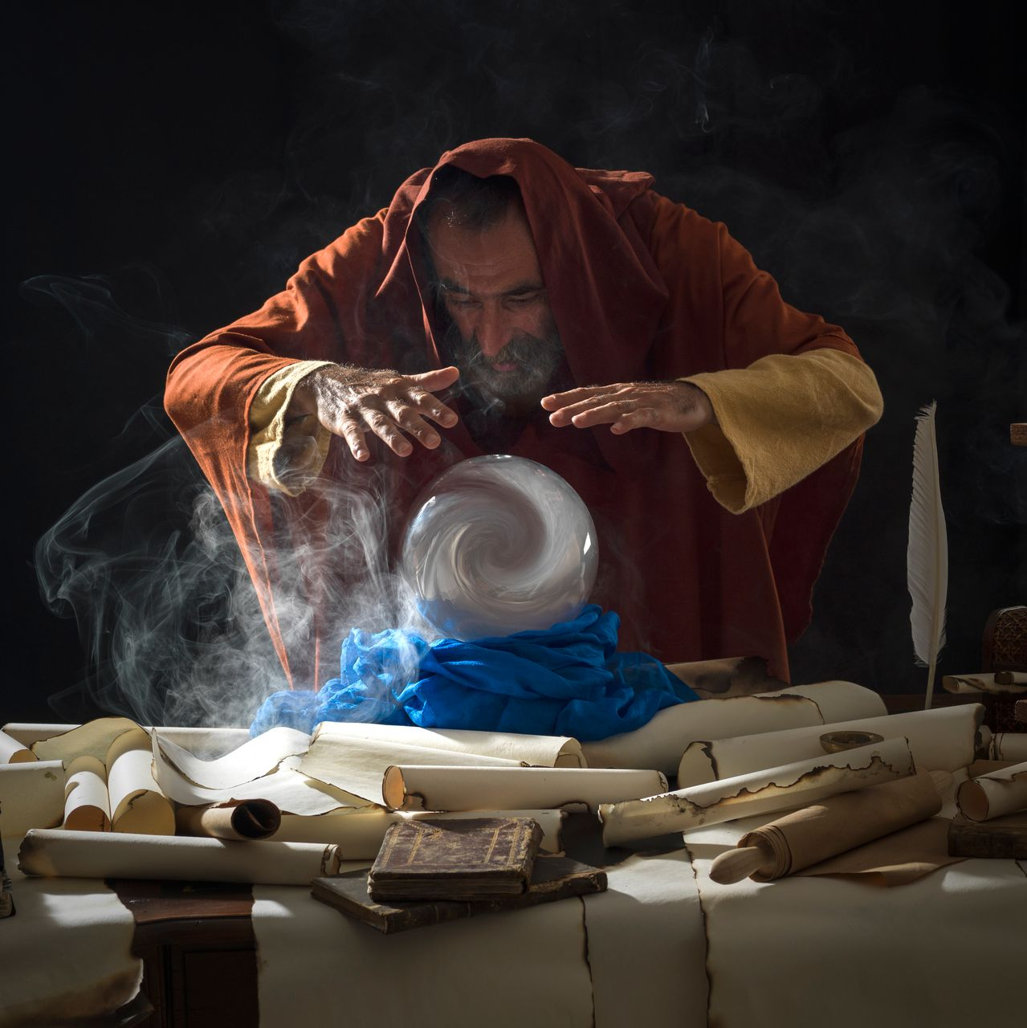
#2 - False prophets (who speak falsely on God’s behalf)

Slide 16
1Jn 4:1 - Beloved, do not believe every spirit, but test the spirits, whether they are of God; because many false prophets have gone out into the world.

Slide 17
#3 - False teachers (those who teach false doctrines)

Slide 18
Tit 1:10 - For there are many insubordinate, both idle talkers and deceivers, especially those of the circumcision,

Slide 19
Tit 1:11 - whose mouths must be stopped, who subvert whole households, teaching things which they ought not, for the sake of dishonest gain.

Slide 20
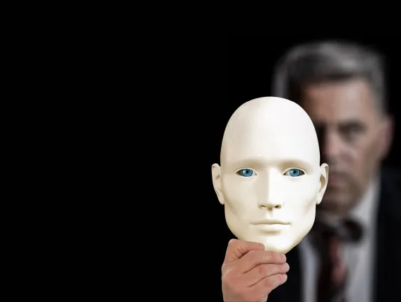
A religious hypocrite will usually have an external show of godliness and be outwardly righteous before men, yet:

Slide 21
They do not fear God – they do whatever they want to do.
They don’t worship God – but merely pray for themselves.
They don’t serve God – never giving of themselves (time, possessions, emotions, etc.).
They don’t allow God to change them!

Slide 22
How to recognize them?

Slide 23
They are not wise -
James 3:13-16
13 - Who is wise and understanding among you? Let him show by good conduct that his works are done in the meekness of wisdom.
14 - But if you have bitter envy and self-seeking in your hearts, do not boast and lie against the truth.

Slide 24
They are not wise -
James 3:13-16
15 - This wisdom does not descend from above, but is earthly, sensual, demonic.
16 - For where envy and self-seeking exist, confusion and every evil thing are there.

Slide 25
They are not hospitable -
3 John 1:9,10
9 - I wrote to the church, but Diotrephes, who loves to have the preeminence among them, does not receive us.

Slide 26
They are not hospitable -
3 John 1:9,10
10 - Therefore, if I come, I will call to mind his deeds which he does, prating against us with malicious words. And not content with that, he himself does not receive the brethren, and forbids those who wish to, putting them out of the church.

Slide 27
They are not holy -
3 John 1:11
Beloved, do not imitate what is evil, but what is good. He who does good is of God, but he who does evil has not seen God.

Slide 28
They do not believe the truth -
John 3:19-21
19 - And this is the condemnation, that the light has come into the world, and men loved darkness rather than light, because their deeds were evil.

Slide 29
They do not believe the truth -
John 3:19-21
20 - For everyone practicing evil hates the light and does not come to the light, lest his deeds should be exposed. .

Slide 30
They do not believe the truth -
John 3:19-21
21 - But he who does the truth comes to the light, that his deeds may be clearly seen, that they have been done in God."

Slide 31
Also, religious hypocrites cause trouble:

Slide 32
They take advantage of the weak:
2 Timothy 3:6
For of this sort are those who creep into households and make captives of gullible women loaded down with sins, led away by various lusts,

Slide 33
They appear to be righteous, but are not:
Matthew 23:27,28
"Woe to you, scribes and Pharisees, hypocrites! For you are like whitewashed tombs which indeed appear beautiful outwardly, but inside are full of dead men's bones and all uncleanness.

Slide 34
They appear to be righteous, but are not:
Matthew 23:27,28
Even so you also outwardly appear righteous to men, but inside you are full of hypocrisy and lawlessness.

Slide 35
They argue and generate strife:
2 Timothy 2:23
But avoid foolish and ignorant disputes, knowing that they generate strife.

Slide 36
They cause others to fall:
Matthew 23:15
"Woe to you, scribes and Pharisees, hypocrites! For you travel land and sea to win one proselyte, and when he is won, you make him twice as much a son of hell as yourselves.

Slide 37
3 manifestations of religious hypocrisy:

Slide 38
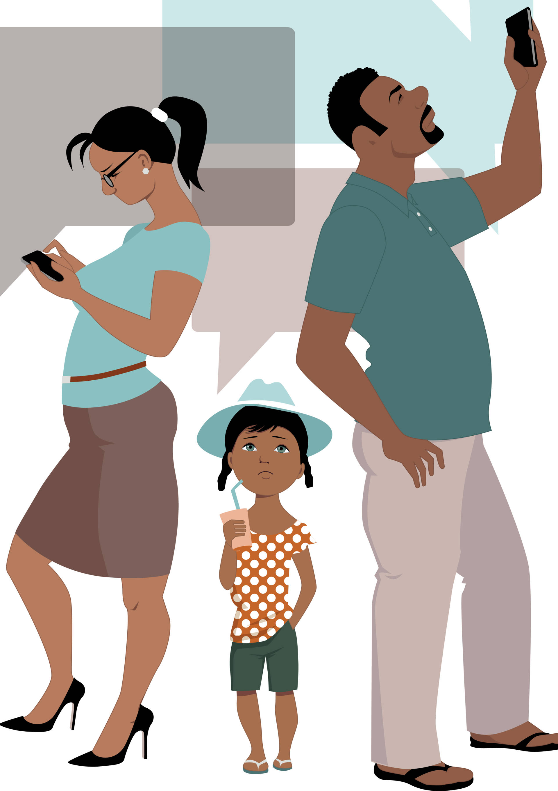
In the home
When we say all the right things in church, yet do all the wrong things at home.
When we treat others in a godly way, yet treat family in an ungodly way.
When our children see ungodliness and hypocrisy in church.

Slide 39
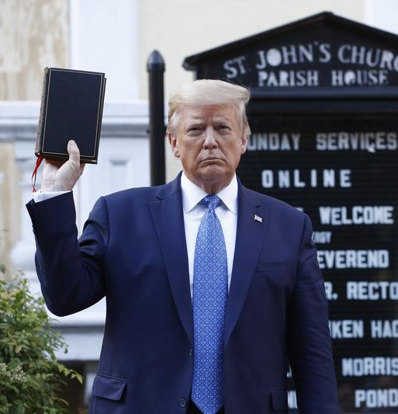
In the media
Those who make claims of belief but do ungodly things
Those who say that they are Christians yet embrace ideas of the world

Slide 40
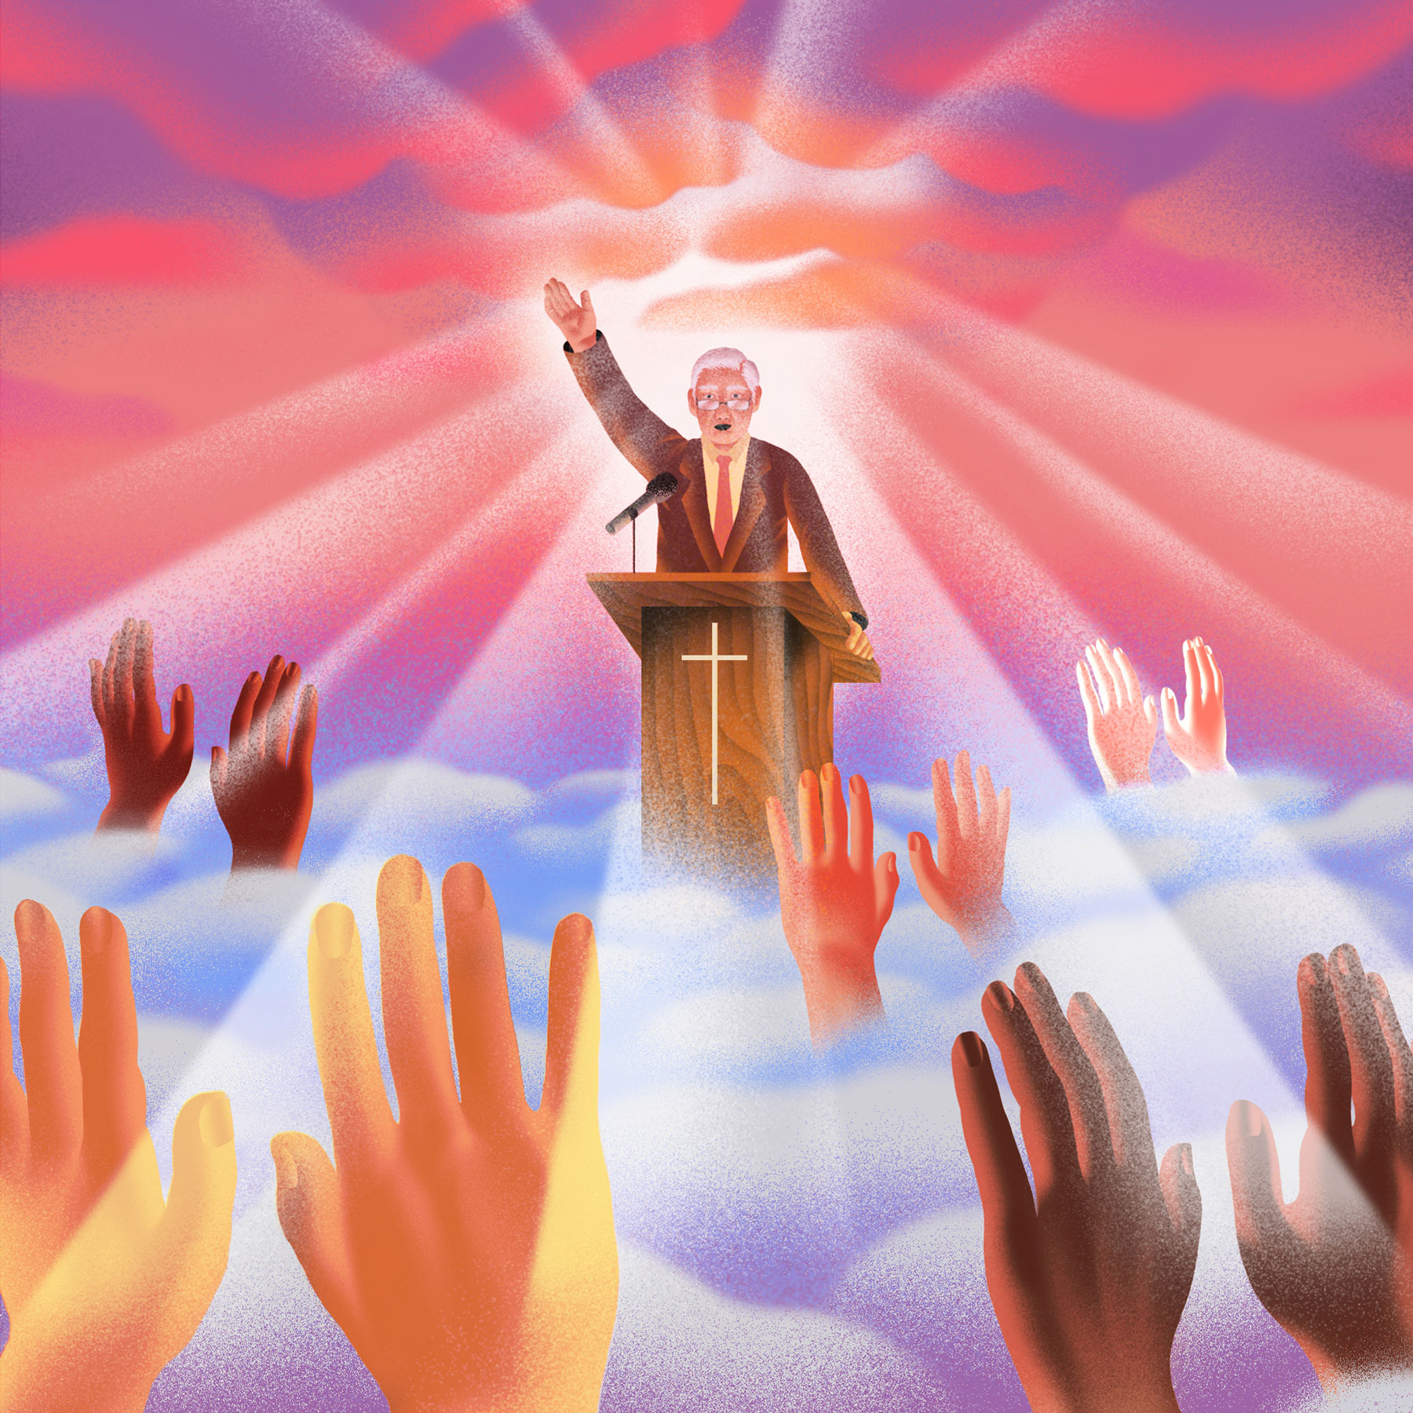
In doctrine/religious circles
Those who use their position as religious leaders to take advantage of people.
Those who claim to be seeking, yet never are able to grasp spiritual truth.
Those who stand against the truth.

Slide 41
What does the bible tell us to do?

Slide 42
Turn away from them:

Slide 43
2Ti 3:5 - having a form of godliness but denying its power. And from such people turn away!

Slide 44
Avoid them:

Slide 45
Rom 16:17 - Now I urge you, brethren, note those who cause divisions and offenses, contrary to the doctrine which you learned, and avoid them.
Notes:
(NIrV) – New International reader’s version – written at a 3rd grade reading level.

Slide 46
Rom 16:18 - For those who are such do not serve our Lord Jesus Christ, but their own belly, and by smooth words and flattering speech deceive the hearts of the simple.

Slide 47
If they are believers we are told…

Slide 48
Turn them back!

Slide 49
Jam 5:19 - Brethren, if anyone among you wanders from the truth, and someone turns him back,

Slide 50
Jam 5:20 - let him know that he who turns a sinner from the error of his way will save a soul from death and cover a multitude of sins.

Slide 51
Restore them:

Slide 52
Gal 6:1 - Brethren, if a man is overtaken in any trespass, you who are spiritual restore such a one in a spirit of gentleness, considering yourself lest you also be tempted.

Slide 53
Admonish them:

Slide 54
2Th 3:14 - And if anyone does not obey our word in this epistle, note that person and do not keep company with him, that he may be ashamed.

Slide 55
2 Th 3:15 - Yet do not count him as an enemy, but admonish him as a brother.

Slide 56
If they will not listen…

Slide 57
Withdraw from them:

Slide 58
1Ti 6:3 - If anyone teaches otherwise and does not consent to wholesome words, even the words of our Lord Jesus Christ, and to the doctrine which accords with godliness,

Slide 59
1Ti 6:4 - he is proud, knowing nothing, but is obsessed with disputes and arguments over words, from which come envy, strife, reviling, evil suspicions,

Slide 60
1Ti 6:5 - useless wranglings of men of corrupt minds and destitute of the truth, who suppose that godliness is a means of gain. From such withdraw yourself.

Slide 61
And eventually, reject them:

Slide 62
Tit 3:10 - Reject a divisive man after the first and second admonition,

Slide 63
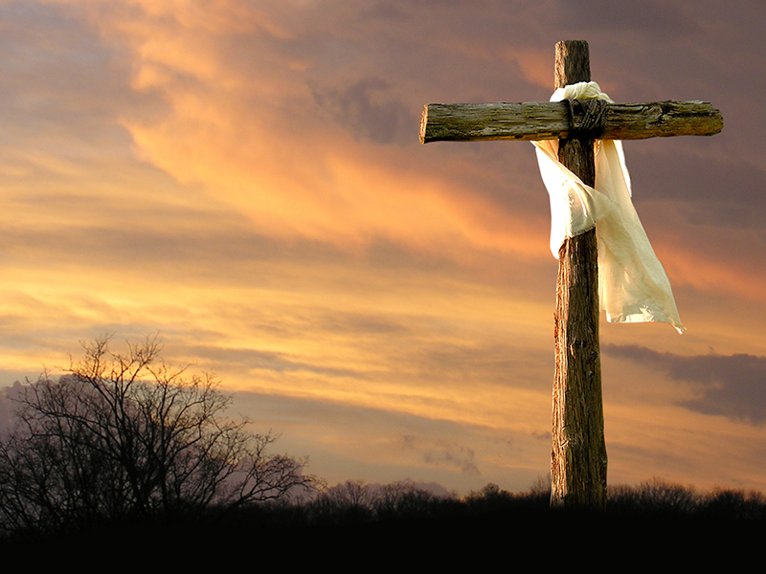
Conclusion: why is this important to know?
So that you are not deceived by them!
So that you do not become one of them!

