Slide 2
Preparation for the Last Days
Notes:
I know that this is “Family month”, but I felt led to continue with the last days for a few reasons:
Because our children are being confronted with the behavior of people in the last days
Because our marriages are breaking up due to selfishness, pride, etc.

Slide 3
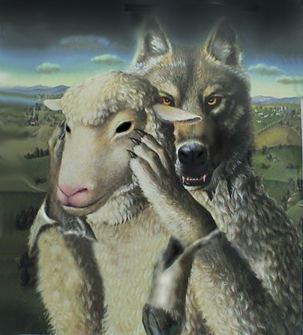
False Prophets & False Teachers
Notes:
I know that this is “Family month”, but I felt led to continue with the last days for a few reasons:
Because our children are being confronted with the behavior of people in the last days
Because our marriages are breaking up due to selfishness, pride, etc.

Slide 4
I want to begin with a statement of fact…

Slide 5
…in these last days, there are false prophets and false teachers.

Slide 6
2Pe 2:1 – But there were also false prophets among the people, even as there will be false teachers among you, who will secretly bring in destructive heresies, even denying the Lord who bought them, and bring on themselves swift destruction.

Slide 7
2Pe 2:2 – And many will follow their destructive ways, because of whom the way of truth will be blasphemed.

Slide 8
2Pe 2:3 – By covetousness they will exploit you with deceptive words; for a long time their judgment has not been idle, and their destruction does not slumber.

Slide 9
So, here are two important questions to consider:

Slide 10
What is a false prophet?

Slide 11
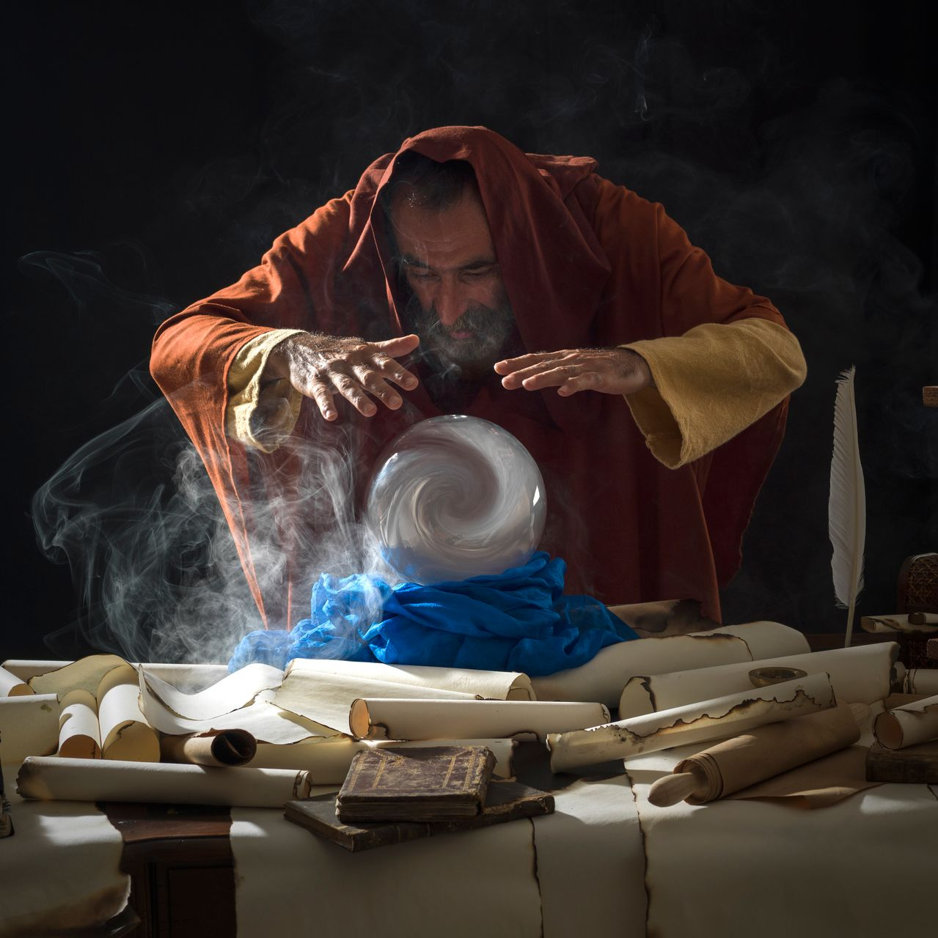
A person who speaks falsely on God’s behalf – they claim to hear from God when they have not.

Slide 12
Jer 14:14 – And the LORD said to me, “The prophets prophesy lies in My name. I have not sent them, commanded them, nor spoken to them; they prophesy to you a false vision, divination, a worthless thing, and the deceit of their heart.

Slide 13
1Jn 4:1 – Beloved, do not believe every spirit, but test the spirits, whether they are of God; because many false prophets have gone out into the world.

Slide 14
Mat 7:15 – “Beware of false prophets, who come to you in sheep’s clothing, but inwardly they are ravenous wolves.

Slide 15
What is a false teacher?

Slide 16
A person who teaches that which is false – that is, contrary to sound doctrine.

Slide 17
2Ti 4:3 – For the time will come when they will not endure sound doctrine, but according to their own desires, because they have itching ears, they will heap up for themselves teachers;

Slide 18
2Ti 4:4 – and they will turn their ears away from the truth, and be turned aside to fables.

Slide 19
Tit 1:10 – For there are many insubordinate, both idle talkers and deceivers, especially those of the circumcision,

Slide 20
Tit 1:11 – whose mouths must be stopped, who subvert whole households, teaching things which they ought not, for the sake of dishonest gain.

Slide 21
Jud 1:4 – For certain men have crept in unnoticed, who long ago were marked out for this condemnation, ungodly men, who turn the grace of our God into lewdness and deny the only Lord God and our Lord Jesus Christ.

Slide 22
How to recognize a false teacher or false prophet:

Slide 23
They take advantage of the weak:

Slide 24
2Ti 3:6 – For of this sort are those who creep into households and make captives of gullible women Loaded down with sins, led away by various lusts…

Slide 25
Mat 23:14 – Woe to you, scribes and Pharisees, hypocrites! For you devour widows’ houses, and for a pretense make long prayers. Therefore you will receive greater condemnation.

Slide 26
They never come to the truth…

Slide 27
2Ti 3:7 – always learning and never able to come to the knowledge of the truth.

Slide 28
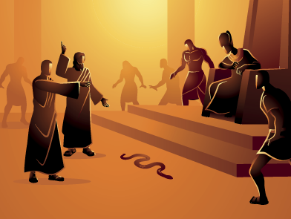
They resist the truth…

Slide 29
2Ti 3:8 – Now as Jannes and Jambres resisted Moses, so do these also resist the truth…

Slide 30
Exo 7:11 – But Pharaoh also called the wise men and the sorcerers; so the magicians of Egypt, they also did in like manner with their enchantments.

Slide 31
Exo 7:12 – For every man threw down his rod, and they became serpents. But Aaron’s rod swallowed up their rods.

Slide 32
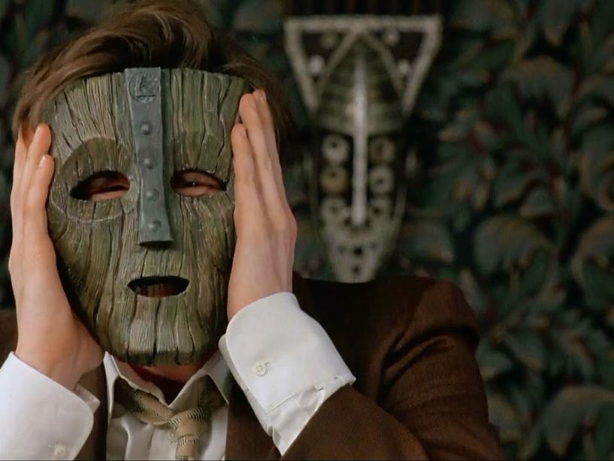
They have corrupt minds…

Slide 33
2Ti 3:8 - … men of corrupt minds, disapproved concerning the faith…

Slide 34
1Ti 6:3 - If anyone teaches otherwise and does not consent to wholesome words, even the words of our Lord Jesus Christ, and to the doctrine which accords with godliness,

Slide 35
1Ti 6:4 - he is proud, knowing nothing, but is obsessed with disputes and arguments over words, from which come envy, strife, reviling, evil suspicions,

Slide 36
1Ti 6:5 - useless wranglings of men of corrupt minds and destitute of the truth, who suppose that godliness is a means of gain. From such withdraw yourself.

Slide 37
They deceive…

Slide 38
Mat 24:11 – Then many false prophets will rise up and deceive many

Slide 39
They can show signs and wonders…

Slide 40
Mar 13:22 – For false christs and false prophets will rise and show signs and wonders to deceive, if possible, even the elect.

Slide 41
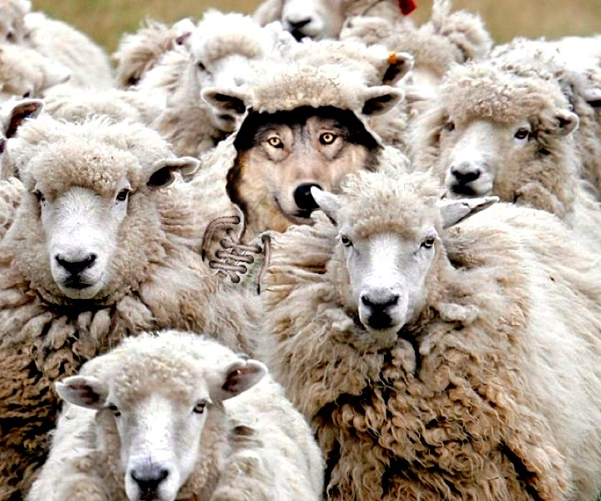
They look like sheep…

Slide 42
Mat 7:15 – “Beware of false prophets, who come to you in sheep’s clothing, but inwardly they are ravenous wolves.

Slide 43
They sneak around…

Slide 44
Gal 2:4 – And this occurred because of false brethren secretly brought in (who came in by stealth to spy out our liberty which we have in Christ Jesus, that they might bring us into bondage)…

Slide 45
But most of all, you will know them by their fruit…

Slide 46
Mat 7:16 – You will know them by their fruits. Do men gather grapes from thornbushes or figs from thistles?

Slide 47
Mat 7:17 – Even so, every good tree bears good fruit, but a bad tree bears bad fruit.

Slide 48
Mat 7:18 – A good tree cannot bear bad fruit, nor can a bad tree bear good fruit.

Slide 49
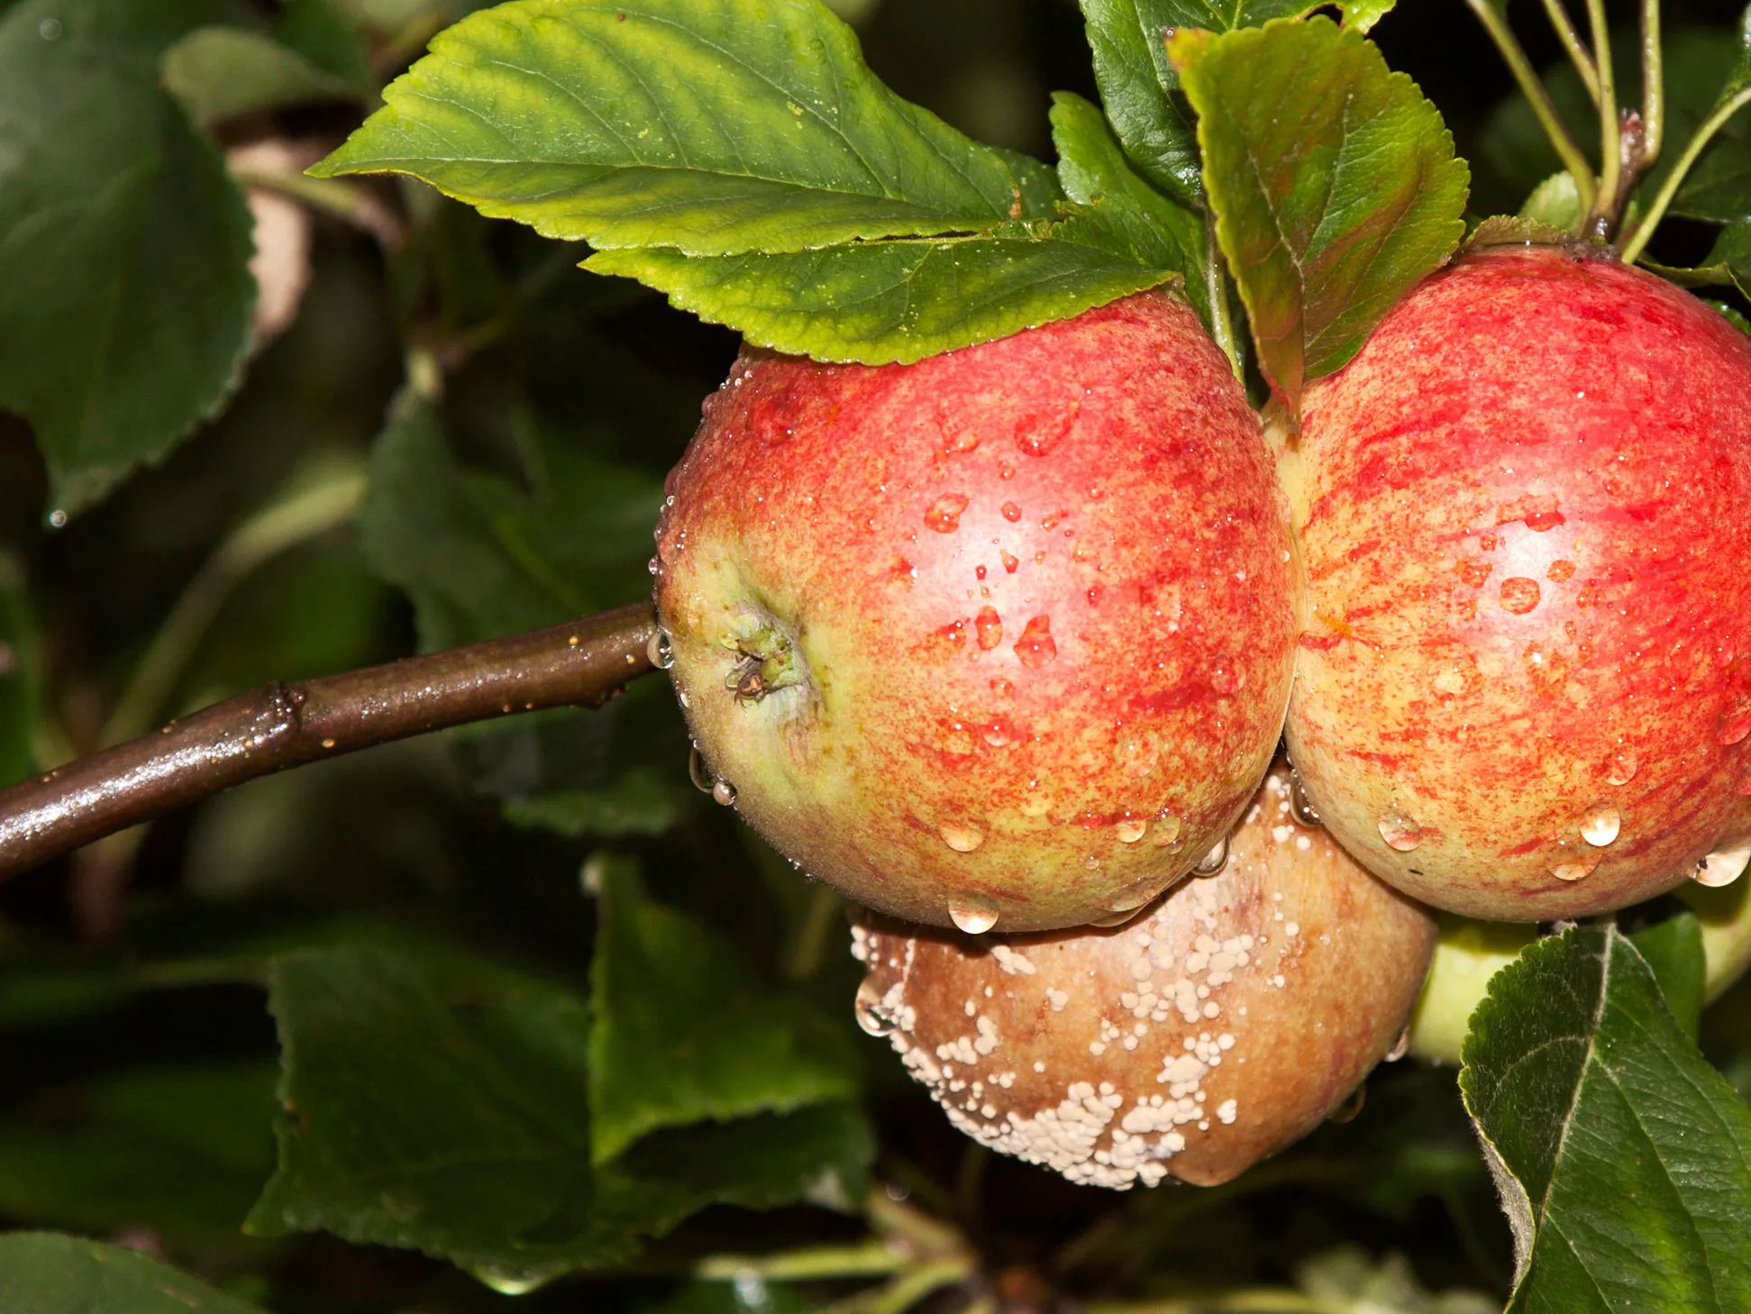
Mat 7:19 – Every tree that does not bear good fruit is cut down and thrown into the fire.

Slide 50
Mat 7:20 – Therefore by their fruits you will know them.

Slide 51
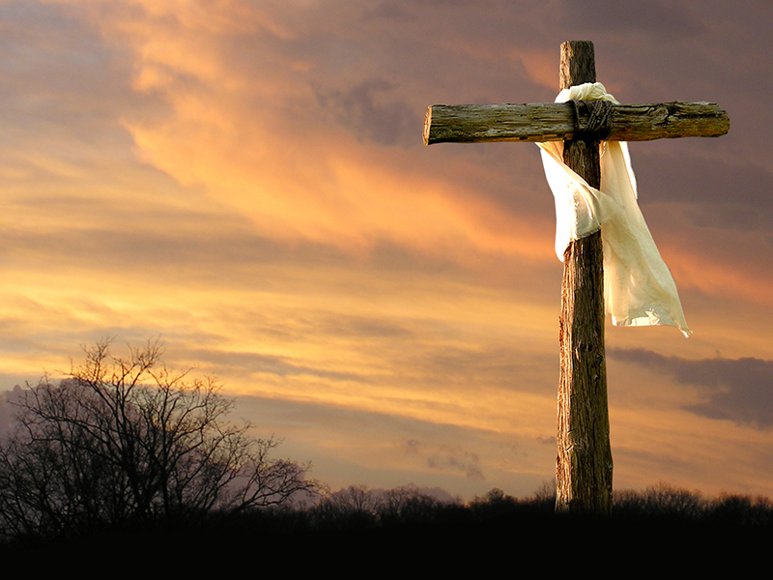
Be warned:
They are here today!
Their teachings are affecting our families, targeting our children and will give you problems!

Slide 52
Don’t be deceived by them!
False prophecy will disappoint you (when the money/healing/wedding does not come)
False teaching will hurt you (the way you raise your children, relate in marriage, acquire self-esteem)

