Slide 2
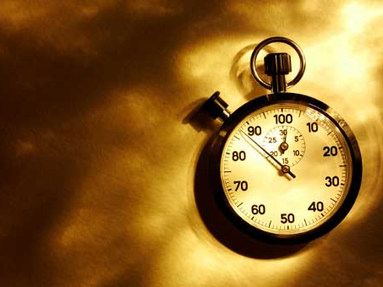
Preparation for the Last Days
Notes:
I know that this is “Family month”, but I felt led to continue with the last days for a few reasons:
Because our children are being confronted with the behavior of people in the last days
Because our marriages are breaking up due to selfishness, pride, etc.

Slide 3
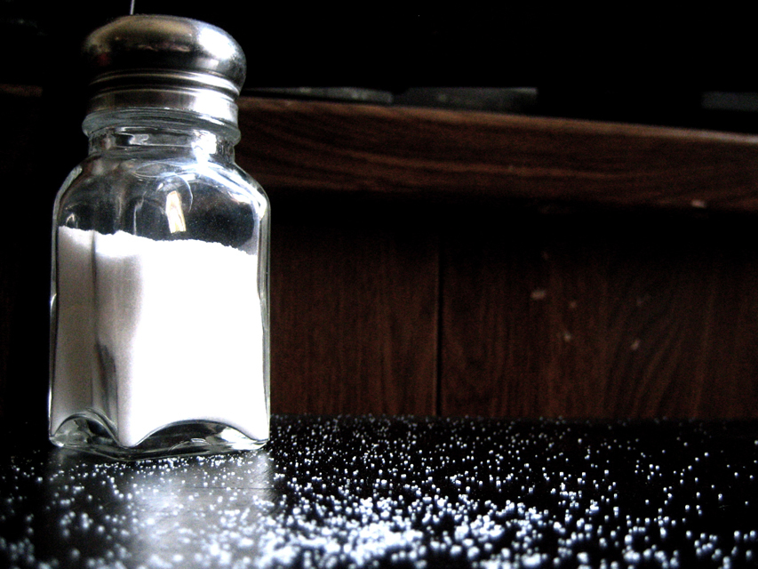
You are the salt of the earth!

Slide 4
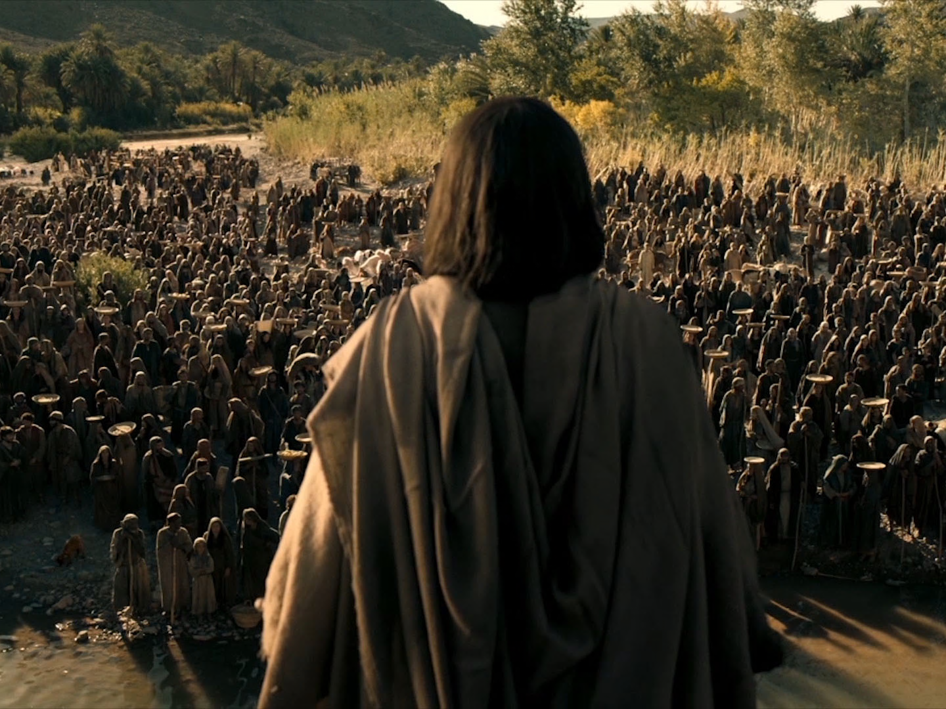
Jesus said to those who were his disciples “You are the salt of the earth”.

Slide 5
But what did he really mean?

Slide 6
I want to answer this question with an explanation and with a warning.

Slide 7
What is salt?

Slide 8
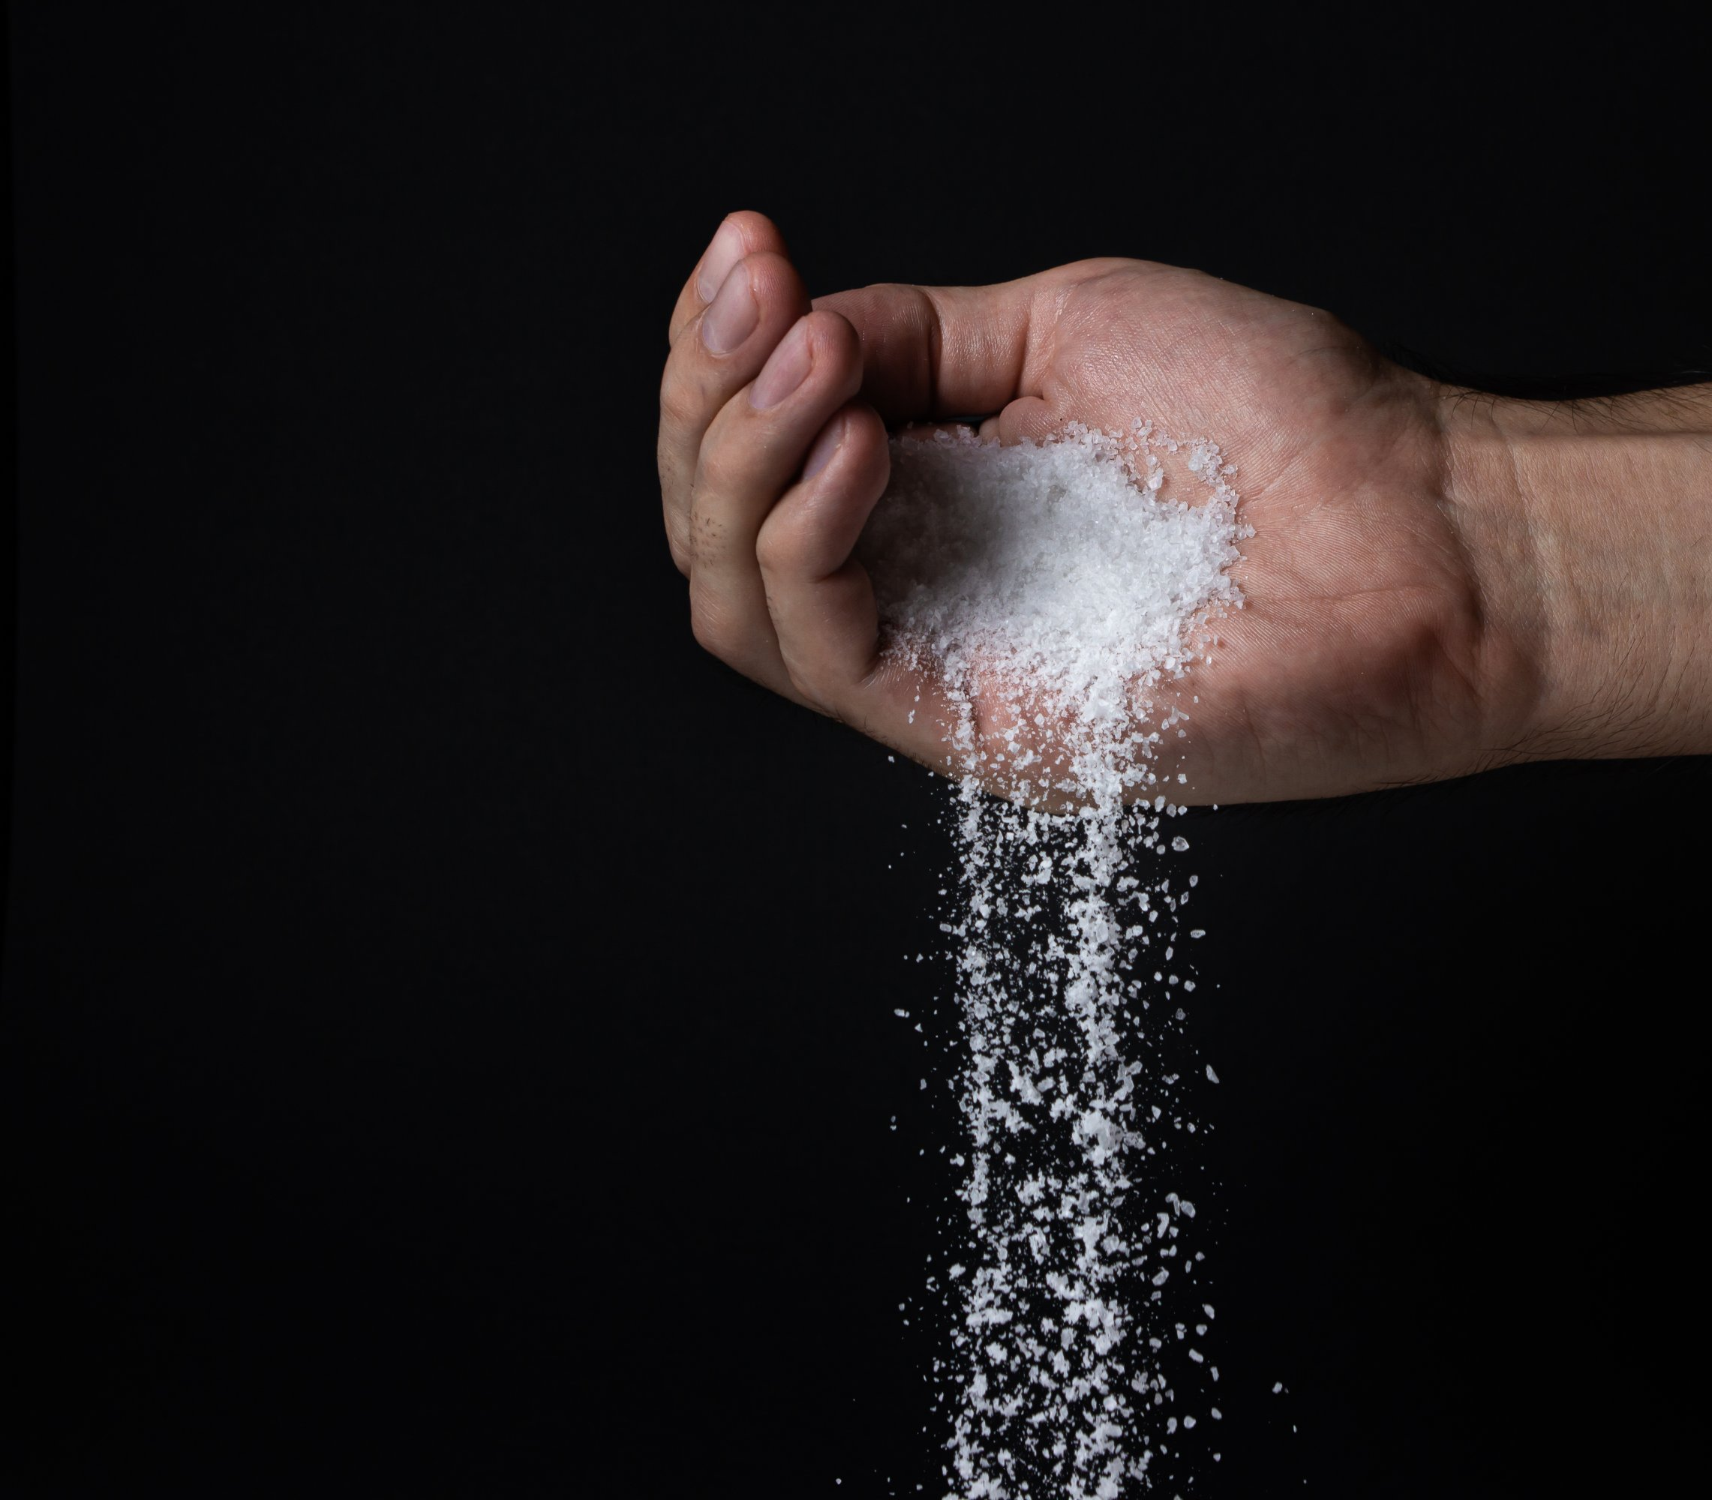
Salt
Salt is common, found in every country and culture around the world.
Salt is simple
Salt is usually unnoticed.
Salt is essential for our health.

Slide 9
Salt
Salt is very useful, used in tanning, bleaching and dyeing and us used to produce things like pottery, soap, leather, detergents, paper, and even medicines.
You can use it to put out fires, clean your oven spills and even to kill poison ivy. You can clean with it, kill weeds, and even keep frost from your car window!

Slide 10
We are the salt of the earth, which means:
We are common, found all over the world
We are simple and often unnoticed
We are essential for the health of our communities and nation
We are very useful!

Slide 11
People who are described as 'the salt of the earth' are those who are considered to be of great worth and reliability.

Slide 12
Oxford definition: A person or group of people of great kindness, reliability, or honesty.

Slide 13
5 main uses of salt:

Slide 14
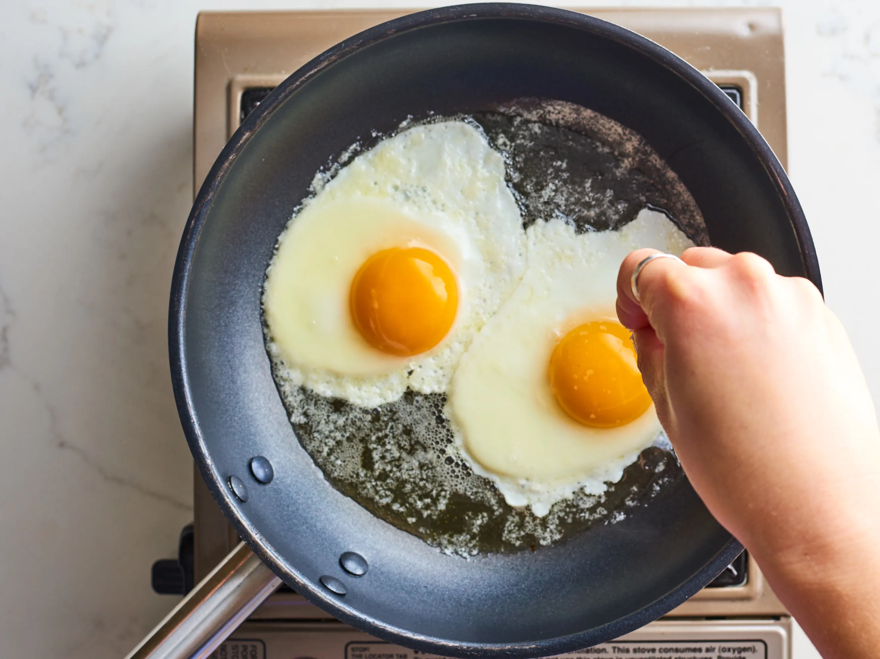
#1 Flavoring - it makes food taste better:
Job 6:6 - Can flavorless food be eaten without salt? Or is there any taste in the white of an egg?
Colossians 4:6 - Let your speech always be with grace, seasoned with salt, that you may know how you ought to answer each one.

Slide 15
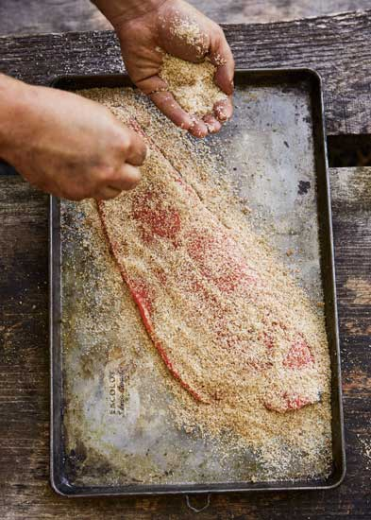
#2 Preserving/purifying If you want to prevent meat from decaying, rub in salt.
Mar 9:49 - "For everyone will be seasoned with fire, and every sacrifice will be seasoned with salt.

Slide 16
#3 Sacrificing – every offering had to be seasoned with salt:
Lev 2:13 - And every offering of your grain offering you shall season with salt; you shall not allow the salt of the covenant of your God to be lacking from your grain offering. With all your offerings you shall offer salt.

Slide 17
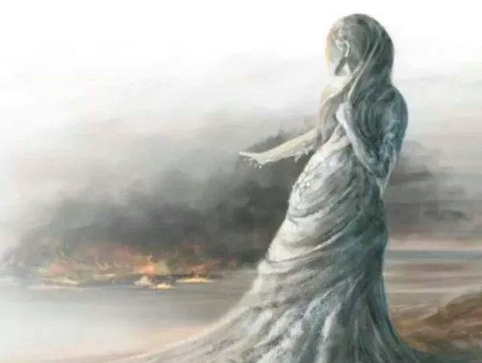
#4 Destroying – salt represented judgment against evil:
Gen 19:26 - But his wife looked back behind him, and she became a pillar of salt.
Jdg 9:45 - So Abimelech fought against the city all that day; he took the city and killed the people who were in it; and he demolished the city and sowed it with salt.

Slide 18
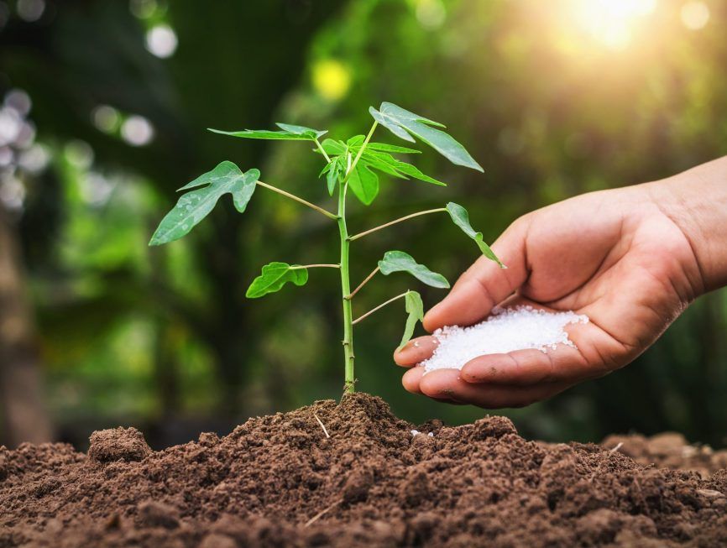
#5 Fertilizing – it can kill weeds, improve the soil and encourage growth
Mar 9:50 - Salt is good, but if the salt loses its flavor, how will you season it? Have salt in yourselves, and have peace with one another."

Slide 19
You are the salt of the earth!
Flavor - you make your world more palatable, even when some do not like it!
Preserving - you preserve your community, preventing it from becoming worse!
Sacrifice - your sacrifice/offering of worship to God brings His presence and blessing wherever you go!

Slide 20
You are the salt of the earth!
Destroying - you destroy the works of the devil by tearing down strongholds in your family and community!
Fertilizer - you bring nourishment to your home and community!

Slide 21
Warning: don’t be surprised if they hate you because of it!

Slide 22
Mat 10:22 - And you will be hated by all for My name's sake. But he who endures to the end will be saved.

Slide 23
Luk 6:22 - Blessed are you when men hate you, And when they exclude you, And revile you, and cast out your name as evil, For the Son of Man's sake.

Slide 24
Joh 15:18 - "If the world hates you, you know that it hated Me before it hated you.

Slide 25
Jon 15:19 - If you were of the world, the world would love its own. Yet because you are not of the world, but I chose you out of the world, therefore the world hates you.

Slide 26
Jon 16:2 - They will put you out of the synagogues; yes, the time is coming that whoever kills you will think that he offers God service.

Slide 27
Jon 16:33 - These things I have spoken to you, that in Me you may have peace. In the world you will have tribulation; but be of good cheer, I have overcome the world."

Slide 28
2Th 3:12 - Yes, and all who desire to live godly in Christ Jesus will suffer persecution.

Slide 29
Why do they hate us?

Slide 30
Because they are carnally minded:

Slide 31
Rom 8:5 - For those who live according to the flesh set their minds on the things of the flesh, but those who live according to the Spirit, the things of the Spirit.

Slide 32
Rom 8:6 - For to be carnally minded is death, but to be spiritually minded is life and peace.

Slide 33
Rom 8:7 - Because the carnal mind is enmity against God; for it is not subject to the law of God, nor indeed can be.

Slide 34
Rom 8:8 - So then, those who are in the flesh cannot please God.

Slide 35
Don’t try to be friends with those who are in the world:

Slide 36
Jam 4:4 - Adulterers and adulteresses! Do you not know that friendship with the world is enmity with God? Whoever therefore wants to be a friend of the world makes himself an enemy of God.

Slide 37
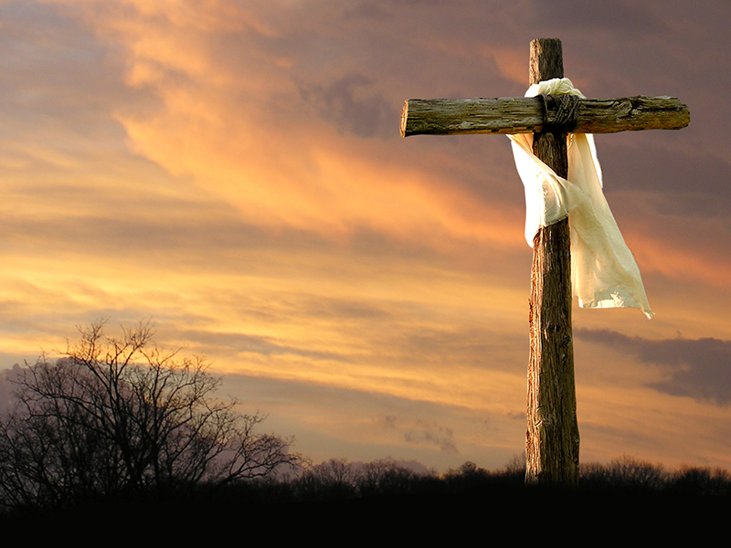
Summary:
You are the salt of the earth!
You are simple, common, often unnoticed, yet you are essential for the health of all that you encounter and are very useful
You make your environment more palatable
You prevent your community from becoming worse
You bring God’s presence wherever you go

Slide 38
Summary:
You destroy and hinder the works of the devil
You nourish your community
Don’t be surprised if the world hates you!
Don’t let it hurt you if the world hates you.
Remember that those who are resisting the spirit are not helping you and are not true friends.

