Slide 2

Notes:
I know that this is “Family month”, but I felt led to continue with the last days for a few reasons:
Because our children are being confronted with the behavior of people in the last days
Because our marriages are breaking up due to selfishness, pride, etc.

Slide 3

We know that we are in the “last days” and that sin and ungodliness is increasing on a global scale.
Notes:
I know that this is “Family month”, but I felt led to continue with the last days for a few reasons:
Because our children are being confronted with the behavior of people in the last days
Because our marriages are breaking up due to selfishness, pride, etc.

Slide 4
But what should we do in response?
Notes:
I know that this is “Family month”, but I felt led to continue with the last days for a few reasons:
Because our children are being confronted with the behavior of people in the last days
Because our marriages are breaking up due to selfishness, pride, etc.

Slide 5
Jesus told us what to do:
Notes:
I know that this is “Family month”, but I felt led to continue with the last days for a few reasons:
Because our children are being confronted with the behavior of people in the last days
Because our marriages are breaking up due to selfishness, pride, etc.

Slide 6
Mat 5:14 - "You are the light of the world. A city that is set on a hill cannot be hidden.

Slide 7
Mat 5:15 - Nor do they light a lamp and put it under a basket, but on a lampstand, and it gives light to all who are in the house.

Slide 8
Mat 5:16 - Let your light so shine before men, that they may see your good works and glorify your Father in heaven.

Slide 9
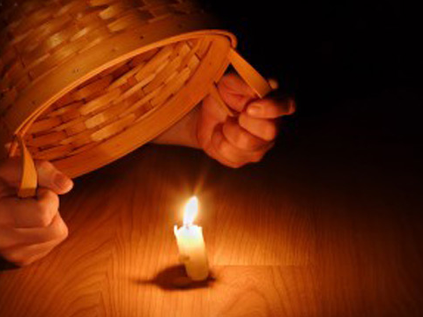
You are the light of the world!

Slide 10
Why light?

Slide 11

Light illuminates -
(It allows you to see!)

Slide 12
Psa 119:105
Your word is a lamp to my feet
And a light to my path.

Slide 13
Psa 43:3
Oh, send out Your light and Your truth!
Let them lead me;
Let them bring me to Your holy hill
And to Your tabernacle.

Slide 14
By living according to God’s word, we find direction and avoid stumbling.

Slide 15
Light must be seen!

Slide 16

Mark 4:21 - Also He said to them, "Is a lamp brought to be put under a basket or under a bed? Is it not to be set on a lampstand?

Slide 17
God gives you light is so that others may see the light and benefit from it.

Slide 18

Light defeats darkness!

Slide 19
Joh 3:18 - "He who believes in Him is not condemned; but he who does not believe is condemned already, because he has not believed in the name of the only begotten Son of God.

Slide 20
Joh 3:19 - And this is the condemnation, that the light has come into the world, and men loved darkness rather than light, because their deeds were evil.

Slide 21
Joh 3:20 - For everyone practicing evil hates the light and does not come to the light, lest his deeds should be exposed.

Slide 22
Joh 3:21 - But he who does the truth comes to the light, that his deeds may be clearly seen, that they have been done in God."

Slide 23
Jesus is the light, who lives in us!

Slide 24

Joh 8:12 - Then Jesus spoke to them again, saying, "I am the light of the world. He who follows Me shall not walk in darkness, but have the light of life."

Slide 25
Joh 1:4 - In Him was life, and the life was the light of men.

Slide 26
Joh 1:5 - And the light shines in the darkness, and the darkness did not comprehend it.

Slide 27
Joh 1:6 - There was a man sent from God, whose name was John.

Slide 28
Joh 1:7 - This man came for a witness, to bear witness of the Light, that all through him might believe.

Slide 29
Joh 1:8 - He was not that Light, but was sent to bear witness of that Light.

Slide 30
Joh 1:9 - That was the true Light which gives light to every man coming into the world.

Slide 31

Walk in the light!

Slide 32
Eph 5:8 - For you were once darkness, but now you are light in the Lord. Walk as children of light

Slide 33
Eph 5:9 - (for the fruit of the Spirit is in all goodness, righteousness, and truth),

Slide 34
Eph 5:10 - finding out what is acceptable to the Lord.

Slide 35
Eph 5:11 - And have no fellowship with the unfruitful works of darkness, but rather expose them.

Slide 36
Eph 5:12 - For it is shameful even to speak of those things which are done by them in secret.

Slide 37
Eph 5:13 - But all things that are exposed are made manifest by the light, for whatever makes manifest is light.

Slide 38
Eph 5:14 - Therefore He says:
"Awake, you who sleep,
Arise from the dead,
And Christ will give you light."

Slide 39
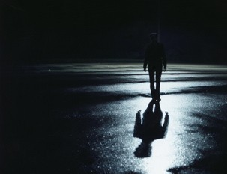
Don’t walk in darkness!

Slide 40

1Jn 1:5 - This is the message which we have heard from Him and declare to you, that God is light and in Him is no darkness at all.

Slide 41
1Jn 1:6 - If we say that we have fellowship with Him, and walk in darkness, we lie and do not practice the truth.

Slide 42
1Jn 1:7 - But if we walk in the light as He is in the light, we have fellowship with one another, and the blood of Jesus Christ His Son cleanses us from all sin.

Slide 43
1Jn 1:8 - If we say that we have no sin, we deceive ourselves, and the truth is not in us.

Slide 44
1Jn 1:9 - If we confess our sins, He is faithful and just to forgive us our sins and to cleanse us from all unrighteousness.

Slide 45
1Jn 1:10 - If we say that we have not sinned, we make Him a liar, and His word is not in us.

Slide 46

So, how do we respond in these last days?
Notes:
I know that this is “Family month”, but I felt led to continue with the last days for a few reasons:
Because our children are being confronted with the behavior of people in the last days
Because our marriages are breaking up due to selfishness, pride, etc.

Slide 47
By being light in the world, which means:
We find direction and avoid stumbling!
We help others to see and make them better!
We expose darkness!

Slide 48
Don’t walk in darkness anymore, walk in the light!

Slide 49
Php 2:14 - Do all things without complaining and disputing,

Slide 50
Php 2:15 - that you may become blameless and harmless, children of God without fault in the midst of a crooked and perverse generation, among whom you shine as lights in the world…

Slide 51
Walk in the light!

