Slide 2
Who are you Following?

Slide 3
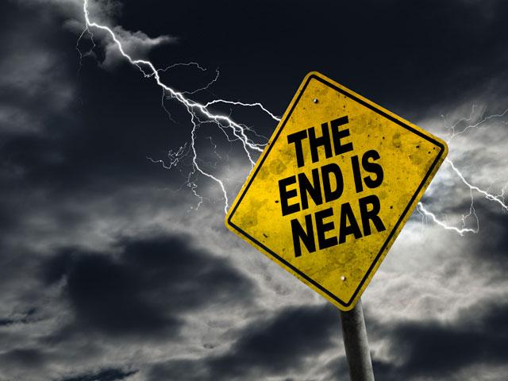
Notes:
I know that this is “Family month”, but I felt led to continue with the last days for a few reasons:
Because our children are being confronted with the behavior of people in the last days
Because our marriages are breaking up due to selfishness, pride, etc.

Slide 4
In Paul’s letter to Timothy, he warned him that difficult times would come in the last days. This is what we have been considering so far:
Notes:
I know that this is “Family month”, but I felt led to continue with the last days for a few reasons:
Because our children are being confronted with the behavior of people in the last days
Because our marriages are breaking up due to selfishness, pride, etc.

Slide 5
2Ti 3:1 - But know this, that in the last days perilous times will come...
Notes:
I know that this is “Family month”, but I felt led to continue with the last days for a few reasons:
Because our children are being confronted with the behavior of people in the last days
Because our marriages are breaking up due to selfishness, pride, etc.

Slide 6
But then he says something important to Timothy:
Notes:
I know that this is “Family month”, but I felt led to continue with the last days for a few reasons:
Because our children are being confronted with the behavior of people in the last days
Because our marriages are breaking up due to selfishness, pride, etc.

Slide 7
“But you…”
Notes:
I know that this is “Family month”, but I felt led to continue with the last days for a few reasons:
Because our children are being confronted with the behavior of people in the last days
Because our marriages are breaking up due to selfishness, pride, etc.

Slide 8
2Ti 3:10 - But you have carefully followed my doctrine, manner of life, purpose, faith, longsuffering, love, perseverance,

Slide 9
2Ti 3:11 - persecutions, afflictions, which happened to me at Antioch, at Iconium, at Lystra—what persecutions I endured. And out of them all the Lord delivered me.

Slide 10
2Ti 3:12 - Yes, and all who desire to live godly in Christ Jesus will suffer persecution.

Slide 11
This means that he expected Timothy to be different from men in the last days and very different from those who resisted the truth.
Notes:
I know that this is “Family month”, but I felt led to continue with the last days for a few reasons:
Because our children are being confronted with the behavior of people in the last days
Because our marriages are breaking up due to selfishness, pride, etc.

Slide 12
Why was Timothy different? Because he pursued a different path. He followed a different pattern.
Notes:
I know that this is “Family month”, but I felt led to continue with the last days for a few reasons:
Because our children are being confronted with the behavior of people in the last days
Because our marriages are breaking up due to selfishness, pride, etc.

Slide 13
If we want to overcome in these last days, we too must pursue a different path and follow a different pattern.
Notes:
I know that this is “Family month”, but I felt led to continue with the last days for a few reasons:
Because our children are being confronted with the behavior of people in the last days
Because our marriages are breaking up due to selfishness, pride, etc.

Slide 14
So, what were the things that Paul taught him?

Slide 15
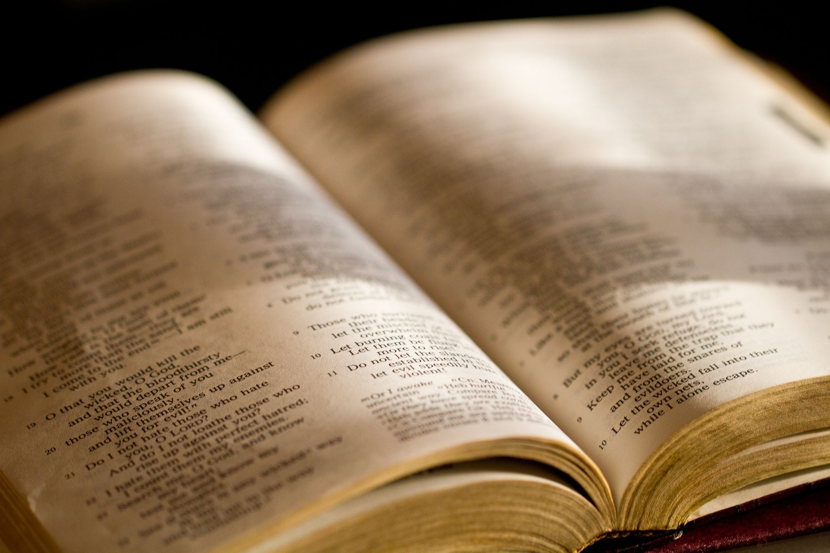
Carefully follow my Doctrine
Who is teaching you?
Is it the teaching of God’s word, or the teachings of false teachers?
Are we drawn to those who are worldly, or to those who are proven to be godly?

Slide 16
2Ti 4:3 - For the time will come when they will not endure sound doctrine, but according to their own desires, because they have itching ears, they will heap up for themselves teachers;

Slide 17
2Ti 4:4 - and they will turn their ears away from the truth, and be turned aside to fables.

Slide 18
Carefully follow my Manner of Life

Slide 19
Carefully follow my Manner of Life
Whose lifestyle are you following?
How do godly people spend their time?
We must not yield to the pressure to do what everyone else is doing.
There are many who follow the path that leads to destruction, and they will pressure you to follow them. Yet deep down inside, you know that their ways are wrong.

Slide 21
Pro 29:25 The fear of man brings a snare, But whoever trusts in the LORD shall be safe.

Slide 22
Carefully follow my Purpose

Slide 23
Carefully follow my Purpose
What is your goal in life?
Are those who you follow living for their own glory, wealth, or for the praises of men?
Most of the people that are idolized these days are living for themselves and will tell you to do the same.
What is your real focus? What is most important to you?

Slide 24
Mat 6:19 - "Do not lay up for yourselves treasures on earth, where moth and rust destroy and where thieves break in and steal;

Slide 25
Mat 6:20 - but lay up for yourselves treasures in heaven, where neither moth nor rust destroys and where thieves do not break in and steal.

Slide 26
Mat 6:21 - For where your treasure is, there your heart will be also.

Slide 27
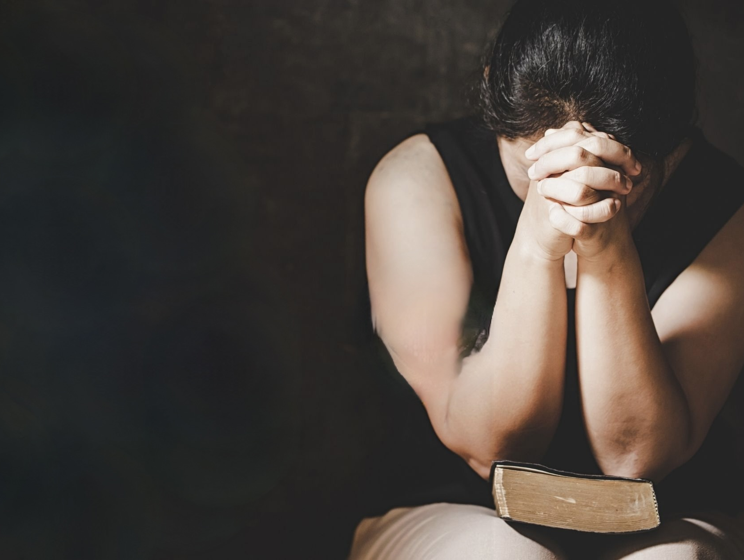
Carefully follow my Faith
Who do you really trust?
Are you following those who really trust God?
You can tell that someone has true faith in God, by what they do.

Slide 28
Jas 2:20 - But do you want to know, O foolish man, that faith without works is dead?

Slide 29
Jas 2:21 - Was not Abraham our father justified by works when he offered Isaac his son on the altar?

Slide 30
Jas 2:22 - Do you see that faith was working together with his works, and by works faith was made perfect?

Slide 31
Jas 2:23 - And the Scripture was fulfilled which says, "ABRAHAM BELIEVED GOD, AND IT WAS ACCOUNTED TO HIM FOR RIGHTEOUSNESS." And he was called the friend of God.

Slide 32
Jas 2:24 - You see then that a man is justified by works, and not by faith only.

Slide 33
Jas 2:25 - Likewise, was not Rahab the harlot also justified by works when she received the messengers and sent them out another way?

Slide 34
Jas 2:26 - For as the body without the spirit is dead, so faith without works is dead also.

Slide 35
So, who are you following? What is your focus? What is your aim? How will you live?

Slide 36
Carefully follow my Longsuffering
What happens when you are wronged?
Are you following those who are hot-headed or those who patiently endure being mistreated and are slow to avenge themselves?

Slide 37
1Pe 2:11 - Beloved, I beg you as sojourners and pilgrims, abstain from fleshly lusts which war against the soul,

Slide 38
1Pe 2:12 - having your conduct honorable among the Gentiles, that when they speak against you as evildoers, they may, by your good works which they observe, glorify God in the day of visitation.

Slide 39
1Pe 3:14 - But even if you should suffer for righteousness' sake, you are blessed. "AND DO NOT BE AFRAID OF THEIR THREATS, NOR BE TROUBLED."

Slide 40
1Pe 3:15 - But sanctify the Lord God in your hearts, and always be ready to give a defense to everyone who asks you a reason for the hope that is in you, with meekness and fear;

Slide 41
1Pe 3:16 - having a good conscience, that when they defame you as evildoers, those who revile your good conduct in Christ may be ashamed.

Slide 42
1Pe 3:17 - For it is better, if it is the will of God, to suffer for doing good than for doing evil.

Slide 43
Carefully follow my Love
Who really loves you?
Do they love you enough to tell you the truth, or do they say what you want them to hear?

Slide 44
Pro 27:5 Open rebuke is better Than love carefully concealed.

Slide 45
Pro 27:6 Faithful are the wounds of a friend, But the kisses of an enemy are deceitful.

Slide 46
Pro 28:23 He who rebukes a man will find more favor afterward Than he who flatters with the tongue.

Slide 47
Carefully follow my Perseverance
Who stays the course and endures?
Who sticks with you to the end?
Can those who you follow take it on the chin and keep on going?
Have they made it through tribulation?

Slide 48
Jas 1:12 - Blessed is the man who endures temptation; for when he has been approved, he will receive the crown of life which the Lord has promised to those who love Him.

Slide 49
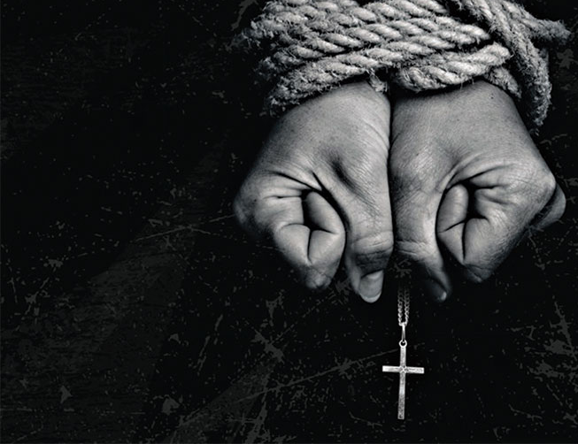
Carefully follow my Persecutions
Does the world love you, or does it hate you?
Are those whom you follow compromising for popularity’s sake?

Slide 50
1Jn 2:15 - Do not love the world or the things in the world. If anyone loves the world, the love of the Father is not in him.

Slide 51
1Jn 2:16 - For all that is in the world—the lust of the flesh, the lust of the eyes, and the pride of life—is not of the Father but is of the world.

Slide 52
2Ti 3:12 - Yes, and all who desire to live godly in Christ Jesus will suffer persecution.

Slide 53
Carefully follow my Afflictions
How much does it cost you?
Are those who you follow willing to make sacrifices and even suffer hardship for the glory of God?
This is mentioned a lot in scripture, yet no one wants to talk about it.
The kingdom of God will cost you!

Slide 54
2Ti 2:11 - This is a faithful saying: For if we died with Him, We shall also live with Him.

Slide 55
2Ti 2:12 - If we endure, We shall also reign with Him. If we deny Him, He also will deny us.

Slide 56
So, what does all this mean?
Notes:
I know that this is “Family month”, but I felt led to continue with the last days for a few reasons:
Because our children are being confronted with the behavior of people in the last days
Because our marriages are breaking up due to selfishness, pride, etc.

Slide 57
It means that if we are to overcome the world (as the bible says), we must have a different focus, a different aim, a different way of living:
Notes:
I know that this is “Family month”, but I felt led to continue with the last days for a few reasons:
Because our children are being confronted with the behavior of people in the last days
Because our marriages are breaking up due to selfishness, pride, etc.

Slide 58
Mat 16:26 – For what profit is it to a man if he gains the whole world, and loses his own soul? Or what will a man give in exchange for his soul?

Slide 59
Mat 7:13 - "Enter by the narrow gate; for wide is the gate and broad is the way that leads to destruction, and there are many who go in by it.

Slide 60
Mat 7:14 - Because narrow is the gate and difficult is the way which leads to life, and there are few who find it.

Slide 61
So, who are you following? What is your focus? What is your aim? How will you live?

