Slide 2
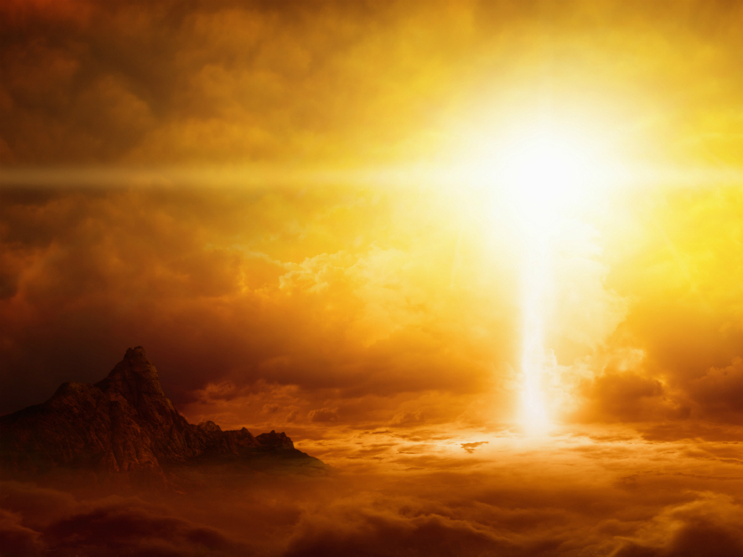
Instructions for the Last Days

Slide 3
How are we as Christians to respond in a world that is becoming more and more ungodly?

Slide 4
Paul gave some specific instructions in his letter to Timothy that should benefit us considerably. Today, we are going to look at the first three of these instructions.
Notes:
I know that this is “Family month”, but I felt led to continue with the last days for a few reasons:
Because our children are being confronted with the behavior of people in the last days
Because our marriages are breaking up due to selfishness, pride, etc.

Slide 5
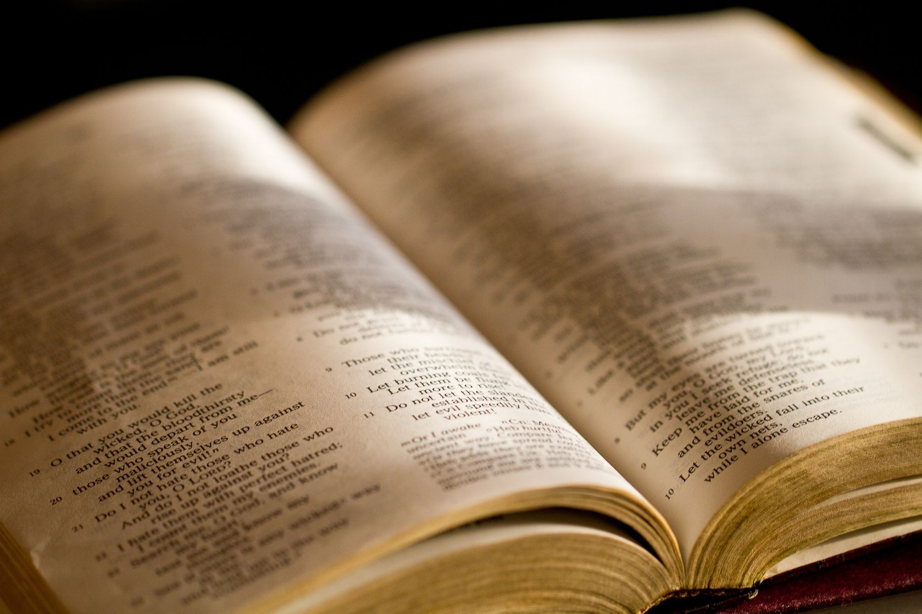
2Ti 2:1 - You therefore, my son, be strong in the grace that is in Christ Jesus.
Notes:
I know that this is “Family month”, but I felt led to continue with the last days for a few reasons:
Because our children are being confronted with the behavior of people in the last days
Because our marriages are breaking up due to selfishness, pride, etc.

Slide 6
2Ti 2:2 - And the things that you have heard from me among many witnesses, commit these to faithful men who will be able to teach others also.
Notes:
I know that this is “Family month”, but I felt led to continue with the last days for a few reasons:
Because our children are being confronted with the behavior of people in the last days
Because our marriages are breaking up due to selfishness, pride, etc.

Slide 7
2Ti 2:3 - You therefore must endure hardship as a good soldier of Jesus Christ.
Notes:
I know that this is “Family month”, but I felt led to continue with the last days for a few reasons:
Because our children are being confronted with the behavior of people in the last days
Because our marriages are breaking up due to selfishness, pride, etc.

Slide 8
2Ti 2:4 - No one engaged in warfare entangles himself with the affairs of this life, that he may please him who enlisted him as a soldier.
Notes:
I know that this is “Family month”, but I felt led to continue with the last days for a few reasons:
Because our children are being confronted with the behavior of people in the last days
Because our marriages are breaking up due to selfishness, pride, etc.

Slide 9
2Ti 2:5 - And also if anyone competes in athletics, he is not crowned unless he competes according to the rules.
Notes:
I know that this is “Family month”, but I felt led to continue with the last days for a few reasons:
Because our children are being confronted with the behavior of people in the last days
Because our marriages are breaking up due to selfishness, pride, etc.

Slide 10
2Ti 2:6 - The hardworking farmer must be first to partake of the crops.
Notes:
I know that this is “Family month”, but I felt led to continue with the last days for a few reasons:
Because our children are being confronted with the behavior of people in the last days
Because our marriages are breaking up due to selfishness, pride, etc.

Slide 11
2Ti 2:7 - Consider what I say, and may the Lord give you understanding in all things.
Notes:
I know that this is “Family month”, but I felt led to continue with the last days for a few reasons:
Because our children are being confronted with the behavior of people in the last days
Because our marriages are breaking up due to selfishness, pride, etc.

Slide 12
#1 - Be strong in the grace that God gives us!
Notes:
I know that this is “Family month”, but I felt led to continue with the last days for a few reasons:
Because our children are being confronted with the behavior of people in the last days
Because our marriages are breaking up due to selfishness, pride, etc.

Slide 13
2Ti 2:1 - You therefore, my son, be strong in the grace that is in Christ Jesus.
Notes:
I know that this is “Family month”, but I felt led to continue with the last days for a few reasons:
Because our children are being confronted with the behavior of people in the last days
Because our marriages are breaking up due to selfishness, pride, etc.

Slide 14
There is an ability that God gives His people that enables us to handle every situation, but we must cultivate it.
Notes:
I know that this is “Family month”, but I felt led to continue with the last days for a few reasons:
Because our children are being confronted with the behavior of people in the last days
Because our marriages are breaking up due to selfishness, pride, etc.

Slide 15
Rom 5:1 - Therefore, having been justified by faith, we have peace with God through our Lord Jesus Christ,
Notes:
I know that this is “Family month”, but I felt led to continue with the last days for a few reasons:
Because our children are being confronted with the behavior of people in the last days
Because our marriages are breaking up due to selfishness, pride, etc.

Slide 16
Rom 5:2 - through whom also we have access by faith into this grace in which we stand, and rejoice in hope of the glory of God.
Notes:
I know that this is “Family month”, but I felt led to continue with the last days for a few reasons:
Because our children are being confronted with the behavior of people in the last days
Because our marriages are breaking up due to selfishness, pride, etc.

Slide 17
1Co 16:13 - Watch, stand fast in the faith, be brave, be strong.
Notes:
I know that this is “Family month”, but I felt led to continue with the last days for a few reasons:
Because our children are being confronted with the behavior of people in the last days
Because our marriages are breaking up due to selfishness, pride, etc.

Slide 18
God’s grace is especially present when we are weak:
Notes:
I know that this is “Family month”, but I felt led to continue with the last days for a few reasons:
Because our children are being confronted with the behavior of people in the last days
Because our marriages are breaking up due to selfishness, pride, etc.

Slide 19
2Co 12:9 - And He said to me, "My grace is sufficient for you, for My strength is made perfect in weakness."

Slide 20
2Co 12:10 - Therefore I take pleasure in infirmities, in reproaches, in needs, in persecutions, in distresses, for Christ's sake. For when I am weak, then I am strong.

Slide 21
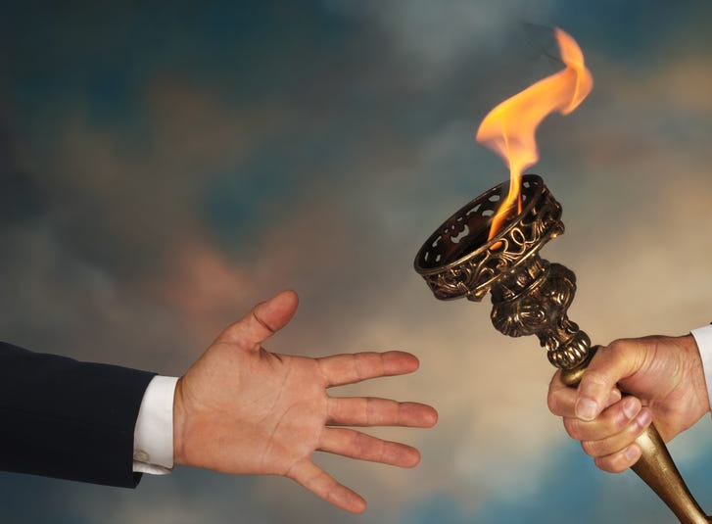
#2 - Pass on what you have heard!

Slide 22
2Ti 2:2 - And the things that you have heard from me among many witnesses, commit these to faithful men who will be able to teach others also.

Slide 23
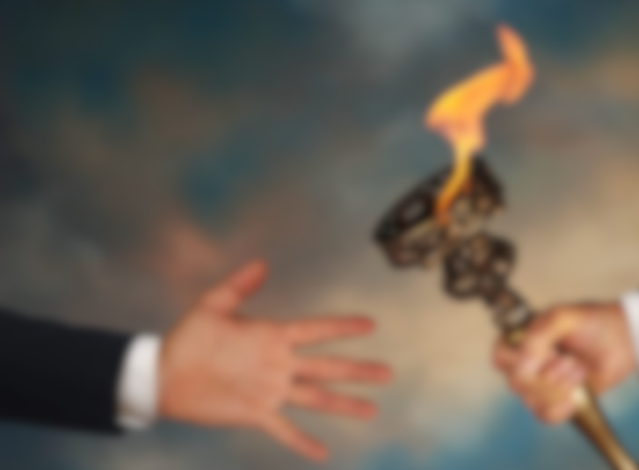
Have you learned from godly parents; teachers, or even from church? Pass it on!
Notes:
I know that this is “Family month”, but I felt led to continue with the last days for a few reasons:
Because our children are being confronted with the behavior of people in the last days
Because our marriages are breaking up due to selfishness, pride, etc.

Slide 24
2Ti 3:14 - But you must continue in the things which you have learned and been assured of, knowing from whom you have learned them,

Slide 25
2Ti 3:15 - and that from childhood you have known the Holy Scriptures, which are able to make you wise for salvation through faith which is in Christ Jesus.

Slide 26
Psa 101:6 - My eyes shall be on the faithful of the land, That they may dwell with me; He who walks in a perfect way, He shall serve me.

Slide 27
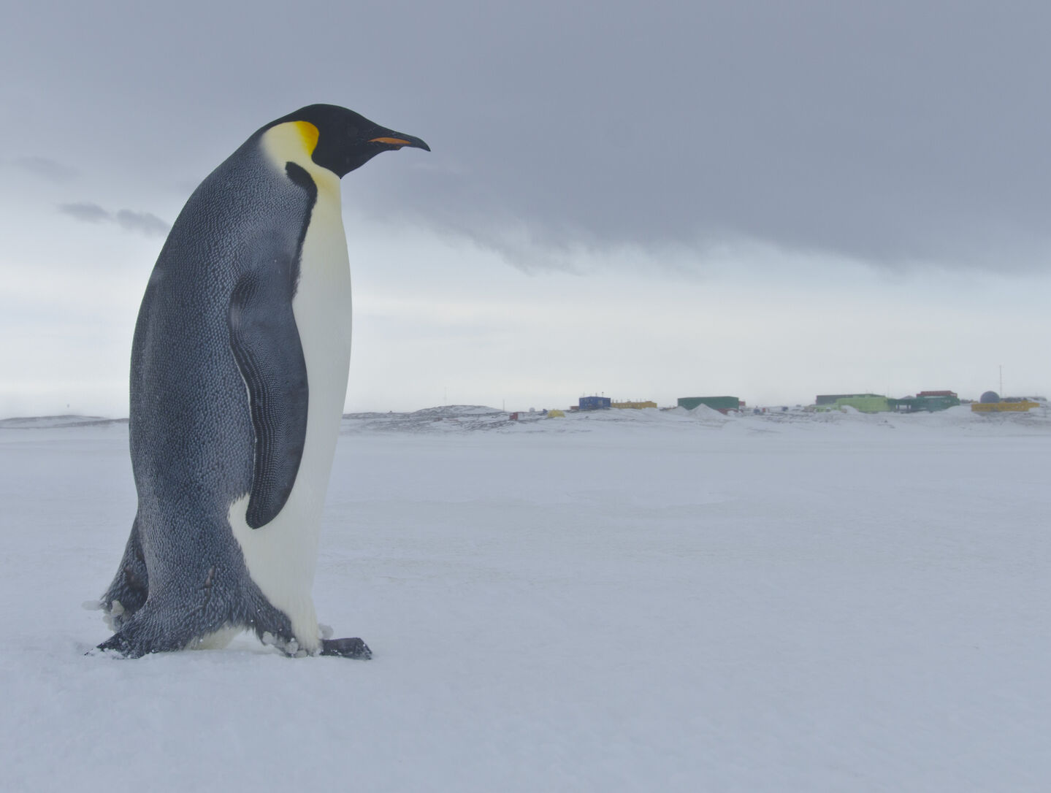
#3 – Endure hardship!

Slide 28
2Ti 2:3 - You therefore must endure hardship as a good soldier of Jesus Christ.

Slide 29
No one likes hardship, but consider what Paul went through:

Slide 30
2Co 11:23 - Are they ministers of Christ?—I speak as a fool—I am more: in labors more abundant, in stripes above measure, in prisons more frequently, in deaths often.

Slide 31
2Co 11:24 - From the Jews five times I received forty stripes minus one.

Slide 32
2Co 11:25 - Three times I was beaten with rods; once I was stoned; three times I was shipwrecked; a night and a day I have been in the deep;

Slide 33
2Co 11:26 - in journeys often, in perils of waters, in perils of robbers, in perils of my own countrymen, in perils of the Gentiles, in perils in the city, in perils in the wilderness, in perils in the sea, in perils among false brethren;

Slide 34
2Co 11:27 - in weariness and toil, in sleeplessness often, in hunger and thirst, in fastings often, in cold and nakedness—

Slide 35
2Co 11:28 - besides the other things, what comes upon me daily: my deep concern for all the churches.

Slide 36
2Co 11:29 - Who is weak, and I am not weak? Who is made to stumble, and I do not burn with indignation?

Slide 37
Paul gives three examples of endurance:

Slide 38
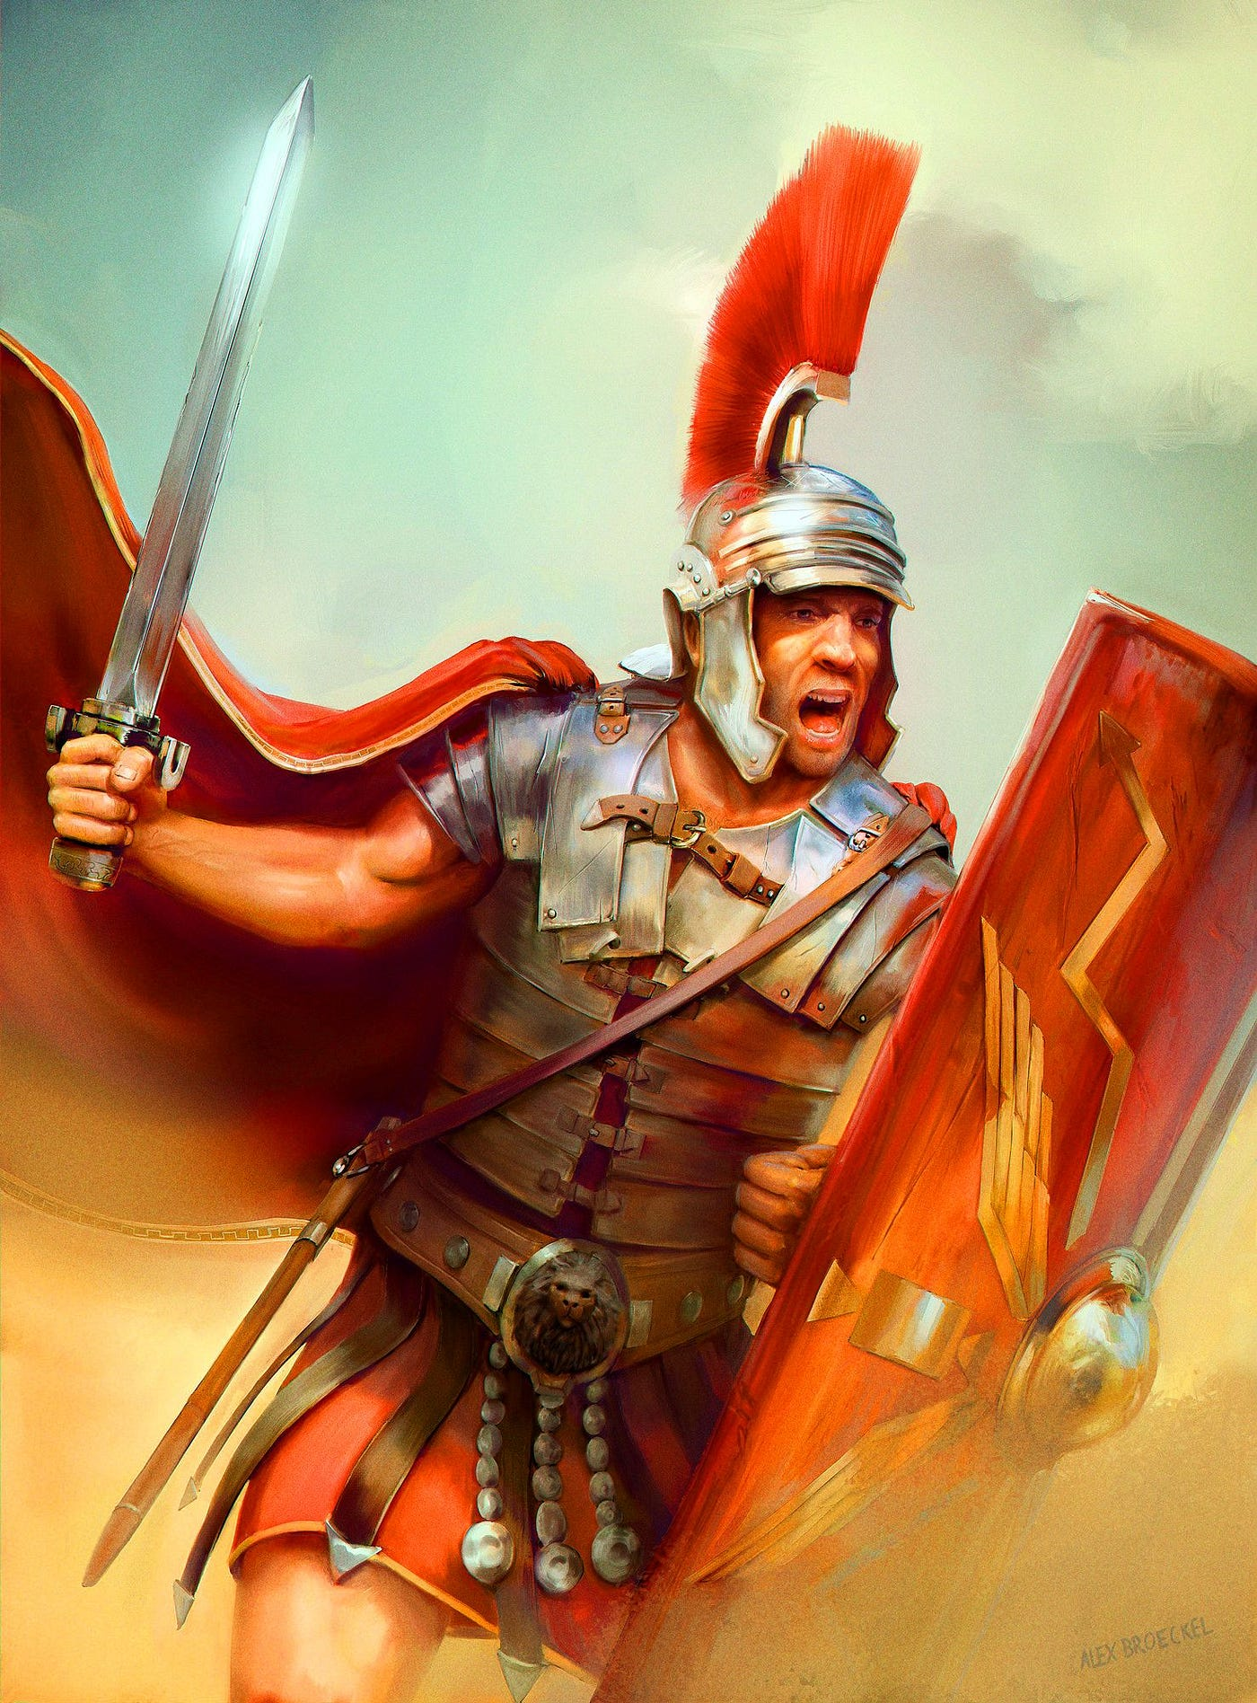
A soldier – who never gets “entangled” with the affairs of this life. He is in the world, but not of the world.

Slide 39
2Ti 2:3 - You therefore must endure hardship as a good soldier of Jesus Christ.

Slide 40
2Ti 2:4 - No one engaged in warfare entangles himself with the affairs of this life, that he may please him who enlisted him as a soldier.

Slide 41
1Jn 2:15 - Do not love the world or the things in the world. If anyone loves the world, the love of the Father is not in him.

Slide 42
1Jn 2:16 - For all that is in the world—the lust of the flesh, the lust of the eyes, and the pride of life—is not of the Father but is of the world.

Slide 43
1Jn 2:17 - And the world is passing away, and the lust of it; but he who does the will of God abides forever.

Slide 44
Luk 8:14 - Now the ones that fell among thorns are those who, when they have heard, go out and are choked with cares, riches, and pleasures of life, and bring no fruit to maturity.

Slide 45
1Ti 6:9 - But those who desire to be rich fall into temptation and a snare, and into many foolish and harmful lusts which drown men in destruction and perdition.

Slide 46
1Ti 6:10 - For the love of money is a root of all kinds of evil, for which some have strayed from the faith in their greediness, and pierced themselves through with many sorrows.

Slide 47
1Ti 6:11 - But you, O man of God, flee these things and pursue righteousness, godliness, faith, love, patience, gentleness.

Slide 48
1Ti 6:12 - Fight the good fight of faith, lay hold on eternal life, to which you were also called and have confessed the good confession in the presence of many witnesses.

Slide 49
2Pe 2:20 - For if, after they have escaped the pollutions of the world through the knowledge of the Lord and Savior Jesus Christ, they are again entangled in them and overcome, the latter end is worse for them than the beginning.

Slide 50
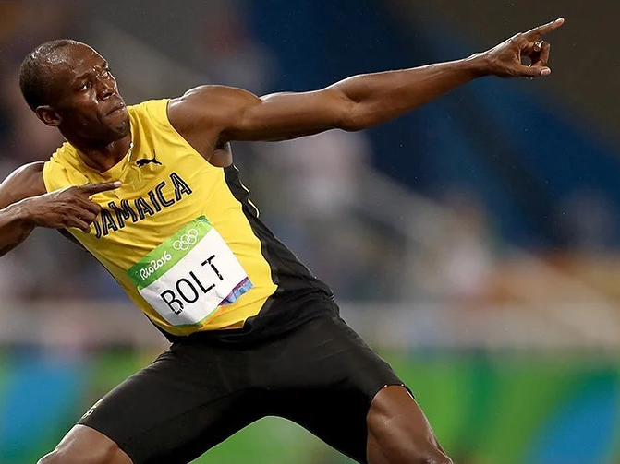
An athlete – who has to obey the rules. God will not compromise just because you are a nice person.
Notes:
I know that this is “Family month”, but I felt led to continue with the last days for a few reasons:
Because our children are being confronted with the behavior of people in the last days
Because our marriages are breaking up due to selfishness, pride, etc.

Slide 51
2Ti 2:5 - And also if anyone competes in athletics, he is not crowned unless he competes according to the rules.

Slide 52
1 Cor 9: 24 Do you not know that those who run in a race all run, but one receives the prize? Run in such a way that you may obtain it.

Slide 53
1 Cor 9: 25 - And everyone who competes for the prize is temperate in all things. Now they do it to obtain a perishable crown, but we for an imperishable crown.

Slide 54
1 Cor 9: 26 - Therefore I run thus: not with uncertainty. Thus I fight: not as one who beats the air.

Slide 55
1 Cor 9: 27 - But I discipline my body and bring it into subjection, lest, when I have preached to others, I myself should become disqualified.

Slide 56
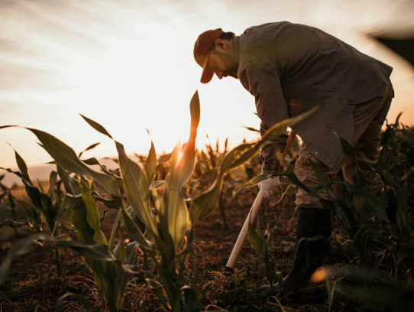
A farmer – who must work hard and be patient.
Notes:
I know that this is “Family month”, but I felt led to continue with the last days for a few reasons:
Because our children are being confronted with the behavior of people in the last days
Because our marriages are breaking up due to selfishness, pride, etc.

Slide 57
2Ti 2:6 - The hardworking farmer must be first to partake of the crops.

Slide 58
1 Cor 9: 7 - Who ever goes to war at his own expense? Who plants a vineyard and does not eat of its fruit? Or who tends a flock and does not drink of the milk of the flock?

Slide 59
1 Cor 9: 8 - Do I say these things as a mere man? Or does not the law say the same also?

Slide 60
1 Cor 9: 9 - For it is written in the law of Moses, "YOU SHALL NOT MUZZLE AN OX WHILE IT TREADS OUT THE GRAIN." Is it oxen God is concerned about?

Slide 61
1 Cor 9: 10 - Or does He say it altogether for our sakes? For our sakes, no doubt, this is written, that he who plows should plow in hope, and he who threshes in hope should be partaker of his hope.

Slide 62
1 Cor 9: 11 - If we have sown spiritual things for you, is it a great thing if we reap your material things?

Slide 63
God will reward all of us according to our deeds. He will never forget our labors and will deal with those who oppose His servants.

Slide 64
Heb 6:10 - For God is not unjust to forget your work and labor of love which you have shown toward His name, in that you have ministered to the saints, and do minister.

Slide 65
Heb 6:11 - And we desire that each one of you show the same diligence to the full assurance of hope until the end,

Slide 66
Heb 6:12 - that you do not become sluggish, but imitate those who through faith and patience inherit the promises.

Slide 67
Gal 6:7 - Do not be deceived, God is not mocked; for whatever a man sows, that he will also reap.

Slide 68
Gal 6:8 - For he who sows to his flesh will of the flesh reap corruption, but he who sows to the Spirit will of the Spirit reap everlasting life.

Slide 69
Gal 6:9 - And let us not grow weary while doing good, for in due season we shall reap if we do not lose heart.

Slide 70
Gal 6:10 - Therefore, as we have opportunity, let us do good to all, especially to those who are of the household of faith.

Slide 71
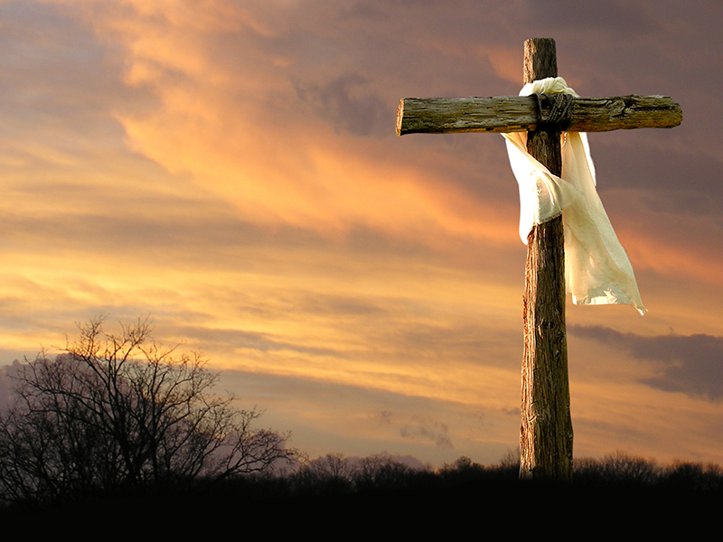
So, what are our instructions in these last days?
Be strong in the grace that God gives us
Pass on what you have heard
Endure hardship

