Slide 2
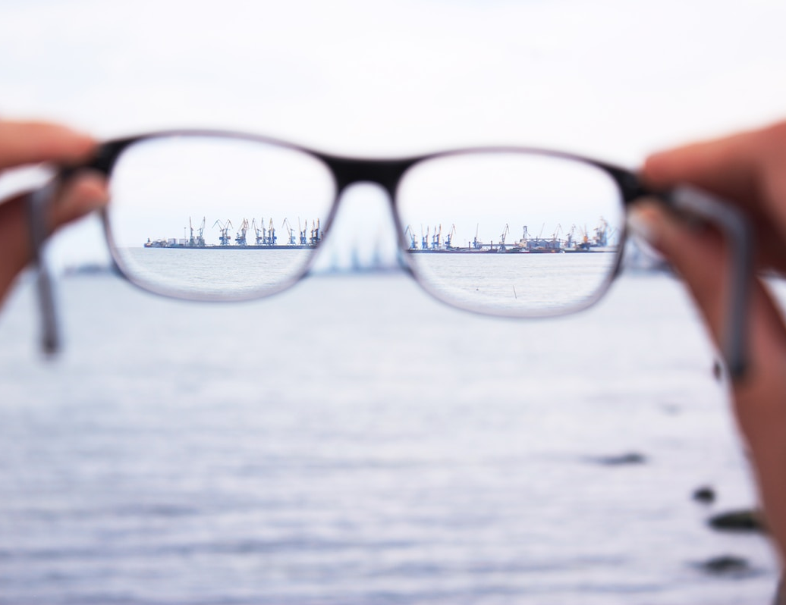
Keep Your Focus!

Slide 3
Are you a soldier? It has been said that believers in Jesus are soldiers for Christ.

Slide 4
But solders have to fight, and soldiers die!

Slide 5
Why would I want to be a soldier? Why would I want to struggle with endurance?

Slide 6
Instead of getting involved in warfare, is it not easier to simply mingle with the crowd?

Slide 7
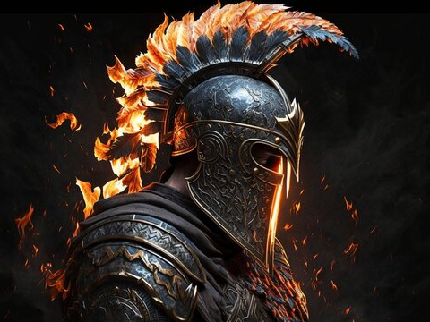
If you are a believer and the Holy Spirit is working in you, sooner or later you are going to become less and less selfish and more concerned for the salvation and welfare of others.
Notes:
I know that this is “Family month”, but I felt led to continue with the last days for a few reasons:
Because our children are being confronted with the behavior of people in the last days
Because our marriages are breaking up due to selfishness, pride, etc.

Slide 8
You may have started thinking only of yourself, but if you continue, you will end up thinking of others. You will become a soldier!
Notes:
I know that this is “Family month”, but I felt led to continue with the last days for a few reasons:
Because our children are being confronted with the behavior of people in the last days
Because our marriages are breaking up due to selfishness, pride, etc.

Slide 9
This is because the Spirit of God is in you and because Jesus becomes your Lord, Master, Ruler.
Notes:
I know that this is “Family month”, but I felt led to continue with the last days for a few reasons:
Because our children are being confronted with the behavior of people in the last days
Because our marriages are breaking up due to selfishness, pride, etc.

Slide 10
In the first part of chapter 2 (vs. 1-7) he tells us to be strong and gives us three examples:
Notes:
I know that this is “Family month”, but I felt led to continue with the last days for a few reasons:
Because our children are being confronted with the behavior of people in the last days
Because our marriages are breaking up due to selfishness, pride, etc.

Slide 11
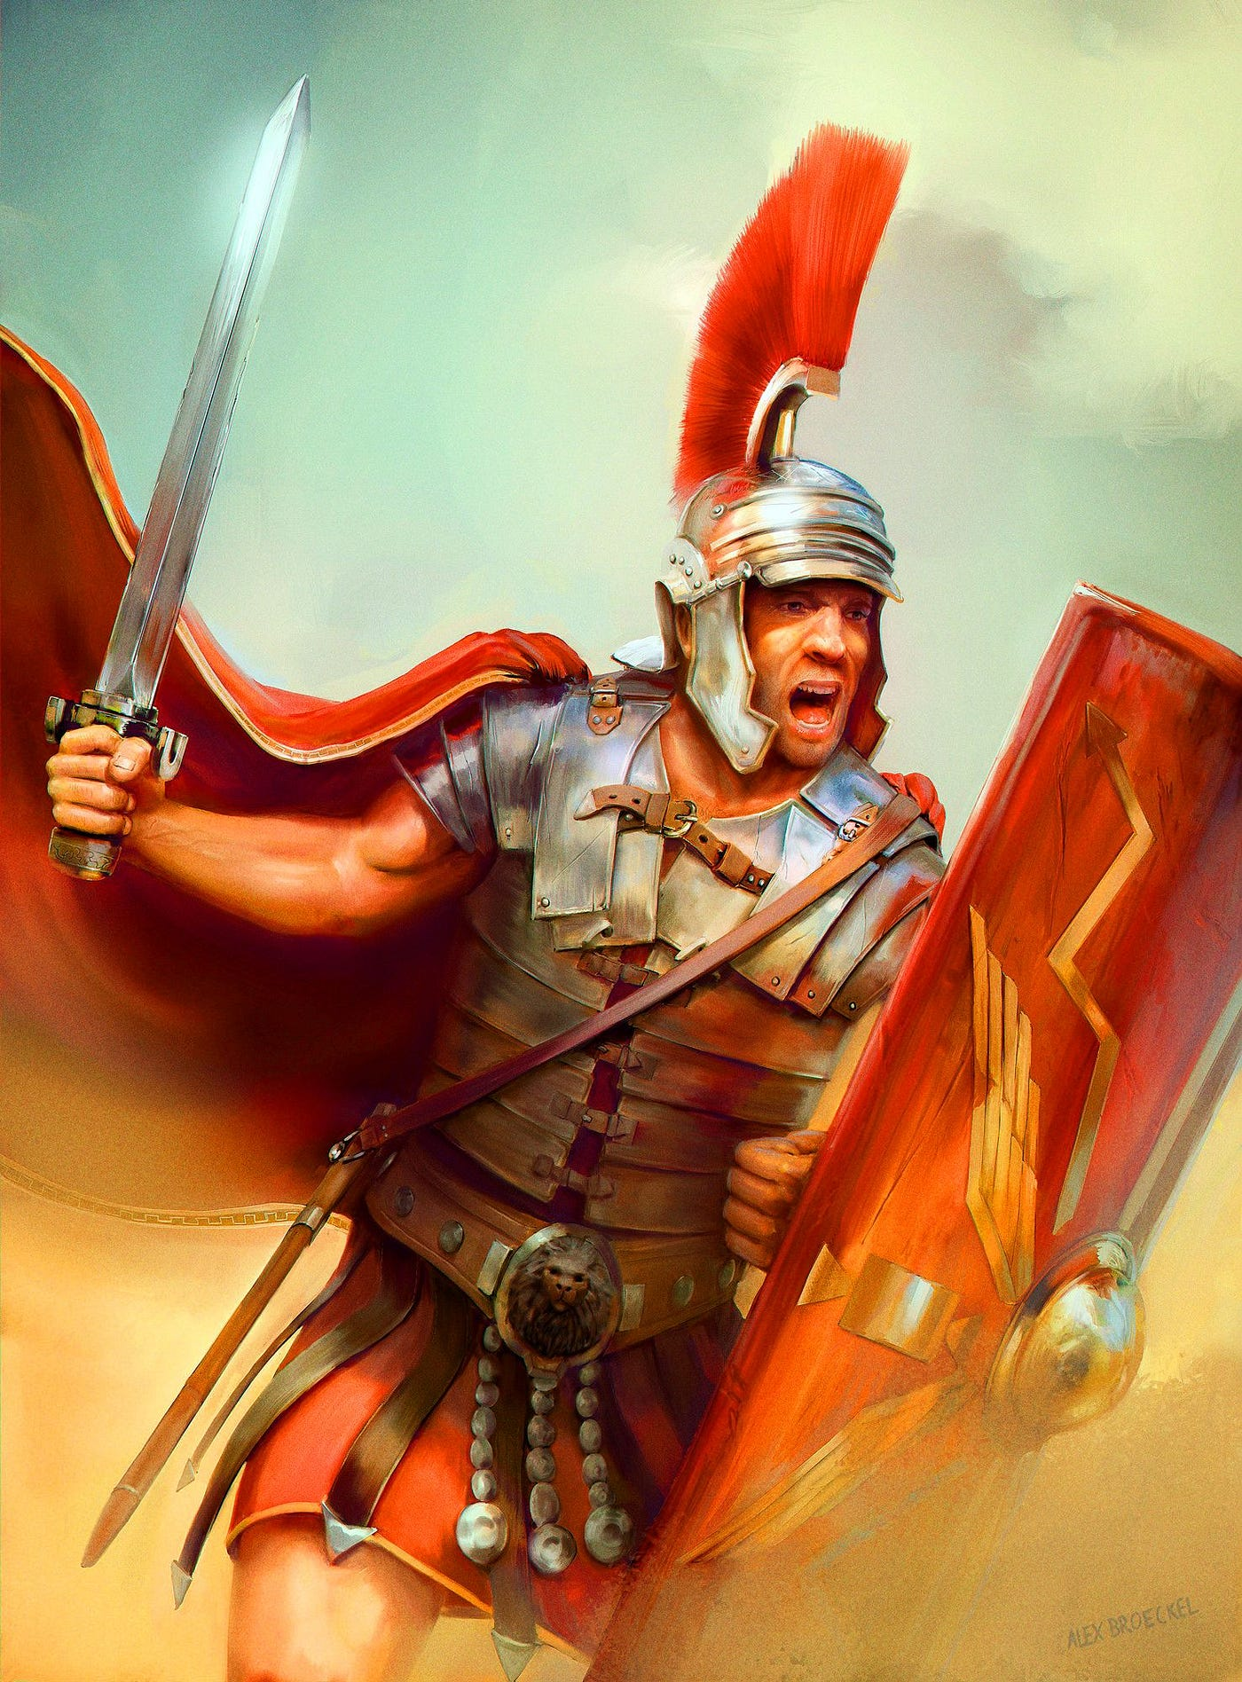
A soldier who endures hardship
Notes:
I know that this is “Family month”, but I felt led to continue with the last days for a few reasons:
Because our children are being confronted with the behavior of people in the last days
Because our marriages are breaking up due to selfishness, pride, etc.

Slide 12
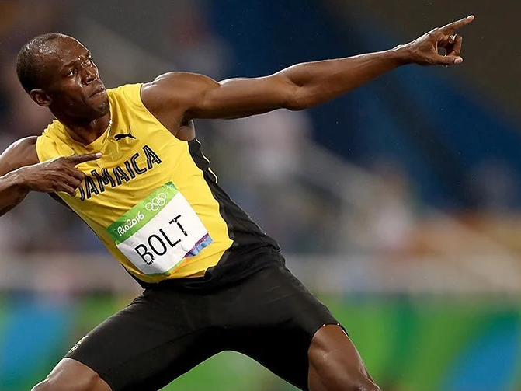
An athlete who competes according to the rules
Notes:
I know that this is “Family month”, but I felt led to continue with the last days for a few reasons:
Because our children are being confronted with the behavior of people in the last days
Because our marriages are breaking up due to selfishness, pride, etc.

Slide 13
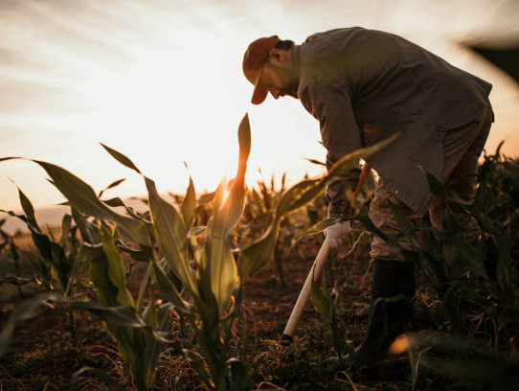
A farmer who is hardworking
Notes:
I know that this is “Family month”, but I felt led to continue with the last days for a few reasons:
Because our children are being confronted with the behavior of people in the last days
Because our marriages are breaking up due to selfishness, pride, etc.

Slide 14
In the second part of chapter 2 he used the word remember to encourage us to keep our focus!
Notes:
I know that this is “Family month”, but I felt led to continue with the last days for a few reasons:
Because our children are being confronted with the behavior of people in the last days
Because our marriages are breaking up due to selfishness, pride, etc.

Slide 15
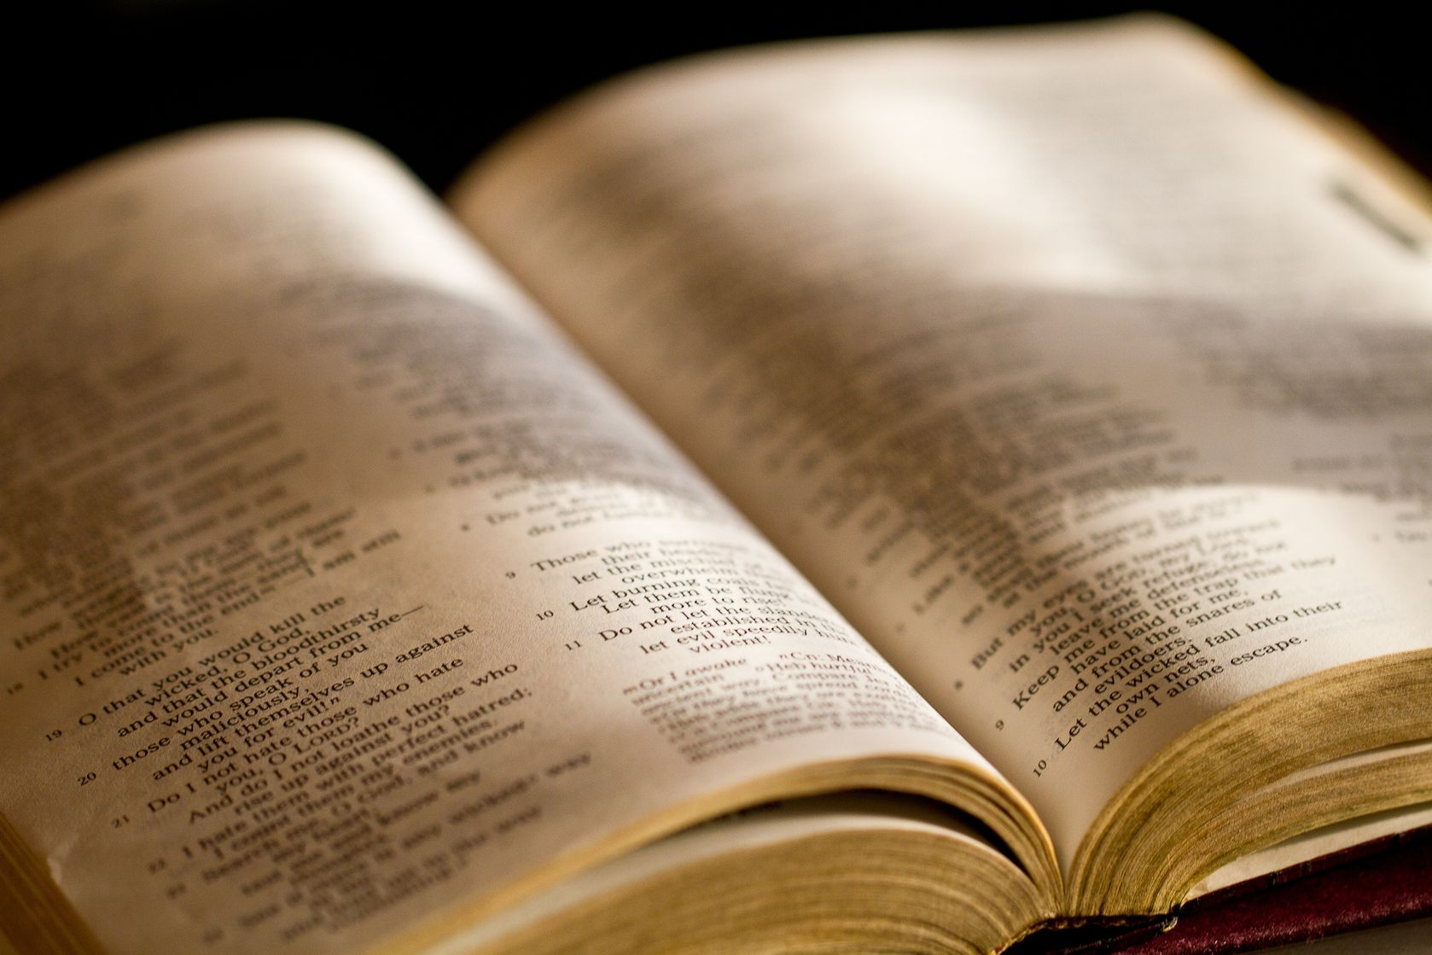
2Ti 2:8 - Remember that Jesus Christ, of the seed of David, was raised from the dead according to my gospel,
Notes:
I know that this is “Family month”, but I felt led to continue with the last days for a few reasons:
Because our children are being confronted with the behavior of people in the last days
Because our marriages are breaking up due to selfishness, pride, etc.

Slide 16
2Ti 2:9 - for which I suffer trouble as an evildoer, even to the point of chains; but the word of God is not chained.
Notes:
I know that this is “Family month”, but I felt led to continue with the last days for a few reasons:
Because our children are being confronted with the behavior of people in the last days
Because our marriages are breaking up due to selfishness, pride, etc.

Slide 17
2Ti 2:10 - Therefore I endure all things for the sake of the elect, that they also may obtain the salvation which is in Christ Jesus with eternal glory.
Notes:
I know that this is “Family month”, but I felt led to continue with the last days for a few reasons:
Because our children are being confronted with the behavior of people in the last days
Because our marriages are breaking up due to selfishness, pride, etc.

Slide 18
2Ti 2:11 - This is a faithful saying: For if we died with Him, We shall also live with Him.
Notes:
I know that this is “Family month”, but I felt led to continue with the last days for a few reasons:
Because our children are being confronted with the behavior of people in the last days
Because our marriages are breaking up due to selfishness, pride, etc.

Slide 19
2Ti 2:12 - If we endure, We shall also reign with Him. If we deny Him, He also will deny us.
Notes:
I know that this is “Family month”, but I felt led to continue with the last days for a few reasons:
Because our children are being confronted with the behavior of people in the last days
Because our marriages are breaking up due to selfishness, pride, etc.

Slide 20
Jesus is the Messiah, the promised one, who proved it by his resurrection. This is the center of what we believe and what we preach.
Notes:
I know that this is “Family month”, but I felt led to continue with the last days for a few reasons:
Because our children are being confronted with the behavior of people in the last days
Because our marriages are breaking up due to selfishness, pride, etc.

Slide 21
Three things to remember:
The resurrection (vs. 8,9)
The elect (v. 10)
The reward (v. 11)

Slide 22
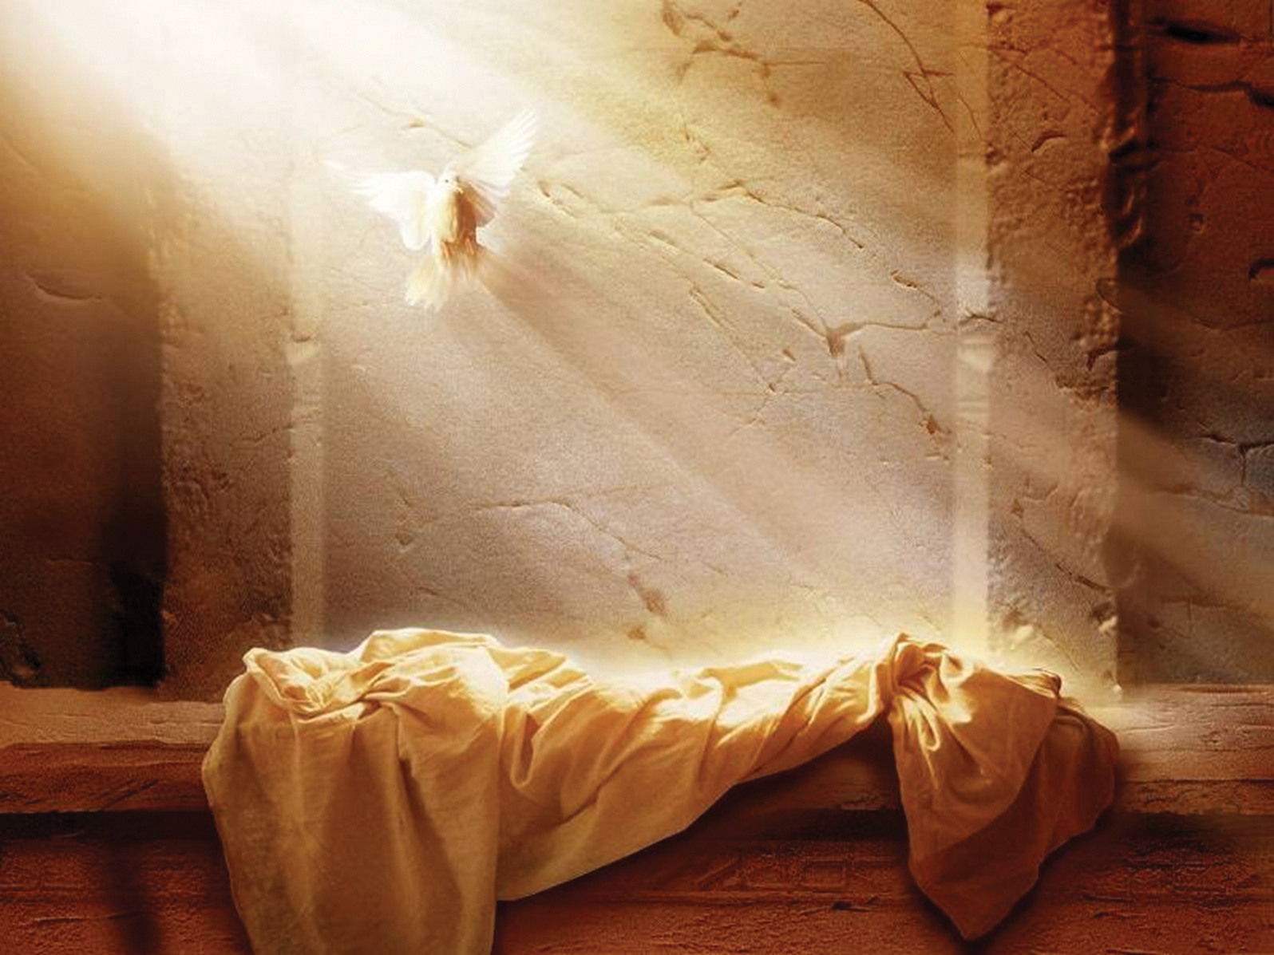
#1 The Resurrection

Slide 23
2Ti 2:8 - Remember that Jesus Christ, of the seed of David, was raised from the dead according to my gospel,
Notes:
I know that this is “Family month”, but I felt led to continue with the last days for a few reasons:
Because our children are being confronted with the behavior of people in the last days
Because our marriages are breaking up due to selfishness, pride, etc.

Slide 24
2Ti 2:9 - for which I suffer trouble as an evildoer, even to the point of chains; but the word of God is not chained.
Notes:
I know that this is “Family month”, but I felt led to continue with the last days for a few reasons:
Because our children are being confronted with the behavior of people in the last days
Because our marriages are breaking up due to selfishness, pride, etc.

Slide 25
Proves that Jesus is the Messiah, the descendant of David, the savior of the world.
Proves that Jesus has the power to change and deliver anyone who believes.
Proves that we will rise again to a new life.

Slide 26
Luk 24:46 - Then He said to them, "Thus it is written, and thus it was necessary for the Christ to suffer and to rise from the dead the third day,
Notes:
I know that this is “Family month”, but I felt led to continue with the last days for a few reasons:
Because our children are being confronted with the behavior of people in the last days
Because our marriages are breaking up due to selfishness, pride, etc.

Slide 27
Luk 24:47 - and that repentance and remission of sins should be preached in His name to all nations, beginning at Jerusalem.
Notes:
I know that this is “Family month”, but I felt led to continue with the last days for a few reasons:
Because our children are being confronted with the behavior of people in the last days
Because our marriages are breaking up due to selfishness, pride, etc.

Slide 28
So, the first thing to focus on is the resurrection of Jesus. What is the second thing to remember?

Slide 29
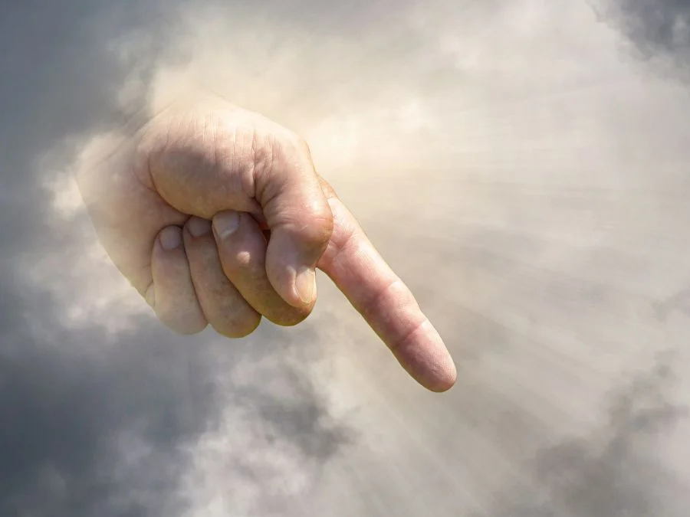
#2 The Elect (chosen)
Notes:
I know that this is “Family month”, but I felt led to continue with the last days for a few reasons:
Because our children are being confronted with the behavior of people in the last days
Because our marriages are breaking up due to selfishness, pride, etc.

Slide 30
2Ti 2:10 - Therefore I endure all things for the sake of the elect, that they also may obtain the salvation which is in Christ Jesus with eternal glory.
Notes:
I know that this is “Family month”, but I felt led to continue with the last days for a few reasons:
Because our children are being confronted with the behavior of people in the last days
Because our marriages are breaking up due to selfishness, pride, etc.

Slide 31
These are those whom God has chosen to be saved.
There is something that we must do – we are witnesses

Slide 32
2Co 1:5 - For as the sufferings of Christ abound in us, so our consolation also abounds through Christ.

Slide 33
2Co 1:6 - Now if we are afflicted, it is for your consolation and salvation, which is effective for enduring the same sufferings which we also suffer. Or if we are comforted, it is for your consolation and salvation.

Slide 34
2Co 1:7 - And our hope for you is steadfast, because we know that as you are partakers of the sufferings, so also you will partake of the consolation.

Slide 35
So, we focus on the resurrection of Jesus, and the elect that need to be saved. What is the third thing to remember?

Slide 36
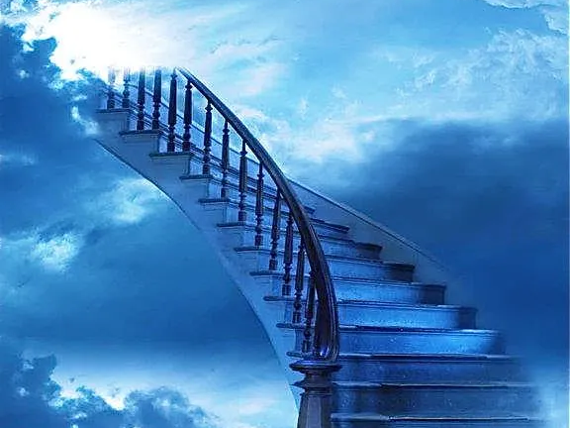
#3 The reward:

Slide 37
2Ti 2:11 - This is a faithful saying: For if we died with Him, We shall also live with Him.

Slide 38
2Ti 2:12 - If we endure, We shall also reign with Him. If we deny Him, He also will deny us.

Slide 39
2Ti 2:13 - If we are faithless, He remains faithful; He cannot deny Himself.

Slide 40
If we die with Him, we live:
Notes:
I know that this is “Family month”, but I felt led to continue with the last days for a few reasons:
Because our children are being confronted with the behavior of people in the last days
Because our marriages are breaking up due to selfishness, pride, etc.

Slide 41
Rom 6:4 - Therefore we were buried with Him through baptism into death, that just as Christ was raised from the dead by the glory of the Father, even so we also should walk in newness of life.

Slide 42
Rom 6:5 - For if we have been united together in the likeness of His death, certainly we also shall be in the likeness of His resurrection,

Slide 43
Rom 6:6 - knowing this, that our old man was crucified with Him, that the body of sin might be done away with, that we should no longer be slaves of sin.

Slide 44
Rom 6:7 - For he who has died has been freed from sin.

Slide 45
Rom 6:8 - Now if we died with Christ, we believe that we shall also live with Him,

Slide 46
If we endure, we reign:

Slide 47
Mat 19:28 - So Jesus said to them, "Assuredly I say to you, that in the regeneration, when the Son of Man sits on the throne of His glory, you who have followed Me will also sit on twelve thrones, judging the twelve tribes of Israel.

Slide 48
Mat 19:29 - And everyone who has left houses or brothers or sisters or father or mother or wife or children or lands, for My name's sake, shall receive a hundredfold, and inherit eternal life.

Slide 49
If we deny, He will do the same:

Slide 50
Mat 10:32 - "Therefore whoever confesses Me before men, him I will also confess before My Father who is in heaven.

Slide 51
Mat 10:33 - But whoever denies Me before men, him I will also deny before My Father who is in heaven.

Slide 52
If we are faithless, He is still faithful:

Slide 53
It doesn’t matter what we or others believe, He is still faithful to His word and will complete His purposes. God’s faithfulness is not affected by human unbelief (C. H. Spurgeon).

Slide 54
Num 23:19 - "God is not a man, that He should lie, Nor a son of man, that He should repent. Has He said, and will He not do? Or has He spoken, and will He not make it good?

Slide 55
So, in these last days we must not just mingle with the crowd. We must remember that we are soldiers and keep our focus:
Notes:
I know that this is “Family month”, but I felt led to continue with the last days for a few reasons:
Because our children are being confronted with the behavior of people in the last days
Because our marriages are breaking up due to selfishness, pride, etc.

Slide 56
Remember the resurrection – proof that Jesus is the savior and can save and deliver anyone
Remember the elect – there are still some out there of whom God wants us to testify so that they can be saved
Remember the reward –
if we die, we live
if we endure, we reign
if we deny, He will deny
if we lose faith, He will still be faithful

Slide 57
Keep your focus!

