Slide 2
After all that we have learned about the difficulties of these last days, here is the last thing that I want you to remember:

Slide 3
Be patient!
Stay focused!
God is up to something!

Slide 4
If you have been a Christian for a while, you probably have read the story of Joseph in the book of Genesis. I want to look at what happened to Joseph in order to show you something that you may not have perceived before.

Slide 5
First let me recap what happened to this man:

Slide 6
Because of his father’s favoritism, he was hated by his brothers:

Slide 7
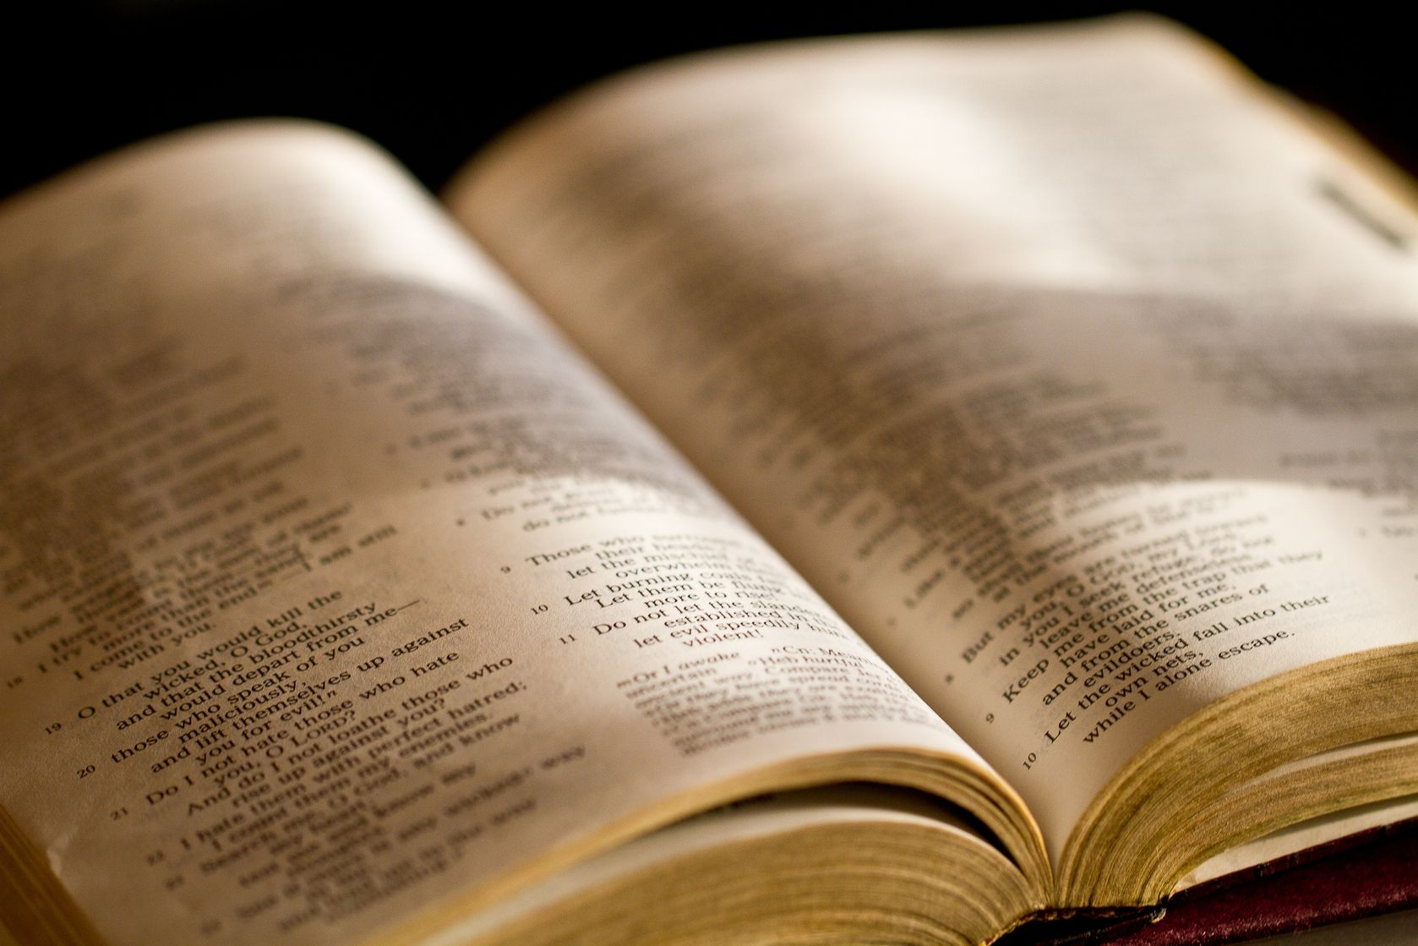
Gen 37:2 - This is the history of Jacob. Joseph, being seventeen years old, was feeding the flock with his brothers. And the lad was with the sons of Bilhah and the sons of Zilpah, his father's wives; and Joseph brought a bad report of them to his father.

Slide 8
Gen 37:3 - Now Israel loved Joseph more than all his children, because he was the son of his old age. Also he made him a tunic of many colors.

Slide 9
Gen 37:4 - But when his brothers saw that their father loved him more than all his brothers, they hated him and could not speak peaceably to him.

Slide 10
Joseph had family problems. Do you have issues in your family?

Slide 11
God gave him a hint of what his purpose would be:

Slide 12
Gen 37:9 - Then he dreamed still another dream and told it to his brothers, and said, "Look, I have dreamed another dream. And this time, the sun, the moon, and the eleven stars bowed down to me."
Notes:
I

Slide 13
Gen 37:10 - So he told it to his father and his brothers; and his father rebuked him and said to him, "What is this dream that you have dreamed? Shall your mother and I and your brothers indeed come to bow down to the earth before you?"

Slide 14
Gen 37:11 - And his brothers envied him, but his father kept the matter in mind.

Slide 15
God had a plan for his life. Does God have a plan for your life?

Slide 16
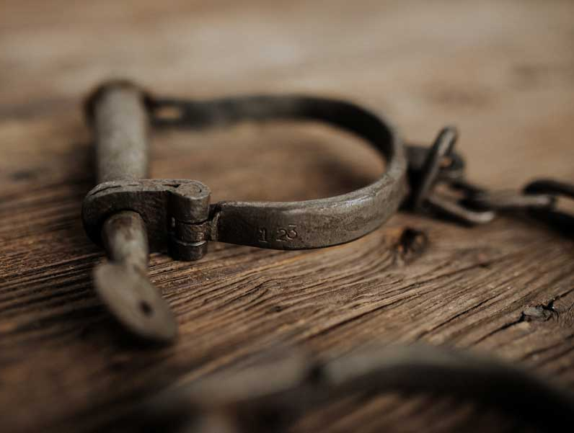
His brothers sell him into slavery and he ends up in an ungodly place; Egypt:

Slide 17
Gen 37:27 - Come and let us sell him to the Ishmaelites, and let not our hand be upon him, for he is our brother and our flesh." And his brothers listened.

Slide 18
Gen 37:28 - Then Midianite traders passed by; so the brothers pulled Joseph up and lifted him out of the pit, and sold him to the Ishmaelites for twenty shekels of silver. And they took Joseph to Egypt.

Slide 19
Do you ever feel as if you don’t belong where you are?

Slide 20
Joseph is blessed by God, but his integrity gets him in trouble:

Slide 21
Gen 39:6 - Thus he left all that he had in Joseph's hand, and he did not know what he had except for the bread which he ate. Now Joseph was handsome in form and appearance.

Slide 22
Gen 39:7 - And it came to pass after these things that his master's wife cast longing eyes on Joseph, and she said, "Lie with me."

Slide 23
Gen 39:8 - But he refused and said to his master's wife, "Look, my master does not know what is with me in the house, and he has committed all that he has to my hand.

Slide 24
Gen 39:9 - There is no one greater in this house than I, nor has he kept back anything from me but you, because you are his wife. How then can I do this great wickedness, and sin against God?"

Slide 25
Have you ever been in trouble for doing the right thing?

Slide 26
He ends up in prison in Egypt, but God is with him even there:

Slide 27
Gen 39:20 - Then Joseph's master took him and put him into the prison, a place where the king's prisoners were confined. And he was there in the prison.

Slide 28
Gen 39:21 - But the LORD was with Joseph and showed him mercy, and He gave him favor in the sight of the keeper of the prison.

Slide 29
Even if you are in a difficult place, God is still with you.

Slide 30
Two years later, God speaks to Pharoah in a dream and Joseph rises to power:

Slide 31
Gen 41:38 - And Pharaoh said to his servants, "Can we find such a one as this, a man in whom is the Spirit of God?"

Slide 32
Gen 41:39 - Then Pharaoh said to Joseph, "Inasmuch as God has shown you all this, there is no one as discerning and wise as you.

Slide 33
Gen 41:40 - You shall be over my house, and all my people shall be ruled according to your word; only in regard to the throne will I be greater than you."

Slide 34
Gen 41:41 - And Pharaoh said to Joseph, "See, I have set you over all the land of Egypt."

Slide 35
With all that happened to Joseph, (betrayal, slavery and even prison), he stayed focus on what God had showed him in his dream.

Slide 36
However, God was up to something much more:

Slide 37
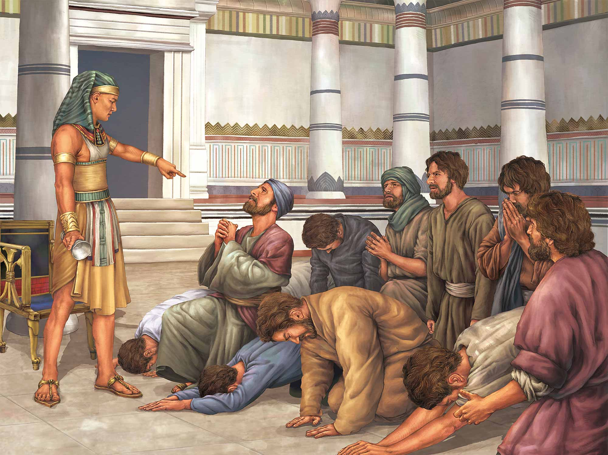
There was something that God did for Joseph’s immediate family:

Slide 38
Gen 45:4 - And Joseph said to his brothers, "Please come near to me." So they came near. Then he said: "I am Joseph your brother, whom you sold into Egypt.

Slide 39
Gen 45:5 - But now, do not therefore be grieved or angry with yourselves because you sold me here; for God sent me before you to preserve life.

Slide 40
Gen 45:6 - For these two years the famine has been in the land, and there are still five years in which there will be neither plowing nor harvesting.

Slide 41
Gen 45:7 - And God sent me before you to preserve a posterity for you in the earth, and to save your lives by a great deliverance.

Slide 42
Joseph had no idea that his troubles were going to save the lives of his entire family.

Slide 43
There was something bigger that his father Jacob understood:

Slide 44
Gen 49:29 - Then he charged them and said to them: "I am to be gathered to my people; bury me with my fathers in the cave that is in the field of Ephron the Hittite,

Slide 45
Gen 49:30 - in the cave that is in the field of Machpelah, which is before Mamre in the land of Canaan, which Abraham bought with the field of Ephron the Hittite as a possession for a burial place.

Slide 46
Gen 49:31 - There they buried Abraham and Sarah his wife, there they buried Isaac and Rebekah his wife, and there I buried Leah.

Slide 47
Gen 49:32 - The field and the cave that is there were purchased from the sons of Heth."

Slide 48
Why did it matter where he was going to be buried?

Slide 49
Because Jacob understood that God was going to bring them back to the land that He had promised them.

Slide 50
There was something bigger that Joseph also understood:

Slide 51
Gen 50:24 - And Joseph said to his brethren, "I am dying; but God will surely visit you, and bring you out of this land to the land of which He swore to Abraham, to Isaac, and to Jacob."

Slide 52
Gen 50:25 - Then Joseph took an oath from the children of Israel, saying, "God will surely visit you, and you shall carry up my bones from here."

Slide 53
Both Jacob and Joseph understood the promise that God made to Abraham and realized that there was something more.

Slide 54
They both focused on the eternal instead of the physical.

Slide 55
Heb 11:13 - These all died in faith, not having received the promises, but having seen them afar off were assured of them, embraced them and confessed that they were strangers and pilgrims on the earth.

Slide 56
Heb 11:14 - For those who say such things declare plainly that they seek a homeland.

Slide 57
Heb 11:15 - And truly if they had called to mind that country from which they had come out, they would have had opportunity to return.

Slide 58
Heb 11:16 - But now they desire a better, that is, a heavenly country. Therefore God is not ashamed to be called their God, for He has prepared a city for them.

Slide 59
Joseph understood that God had a purpose that was far bigger than his immediate circumstances. He embraced it, and kept his focus on God’s purpose for the future:

Slide 60
Heb 11:22 - By faith Joseph, when he was dying, made mention of the departure of the children of Israel, and gave instructions concerning his bones.

Slide 61
Are you a child of God? Do you love God? Even though you may not realize it, understand it, or even know it, God is at work for good!

Slide 62
Rom 8:28 - And we know that all things work together for good to those who love God, to those who are the called according to His purpose.

Slide 63
Rom 8:29 - For whom He foreknew, He also predestined to be conformed to the image of His Son, that He might be the firstborn among many brethren.

Slide 64
Rom 8:30 - Moreover whom He predestined, these He also called; whom He called, these He also justified; and whom He justified, these He also glorified.

Slide 65
1Pe 5:10 - But may the God of all grace, who called us to His eternal glory by Christ Jesus, after you have suffered a while, perfect, establish, strengthen, and settle you.

Slide 66
1Pe 5:11 - To Him be the glory and the dominion forever and ever. Amen.

Slide 67
Be patient!
Stay focused!
God is up to something!

