Slide 2
Do you ever feel that things seem to get worse when you try to do good?

Slide 3
Do you ever get discouraged when you see ungodly people that seem to prosper, yet things remain difficult for you.

Slide 4
Does it bother you when people do wrong and seem to get away with it?

Slide 5
Well, you are not the first:

Slide 6
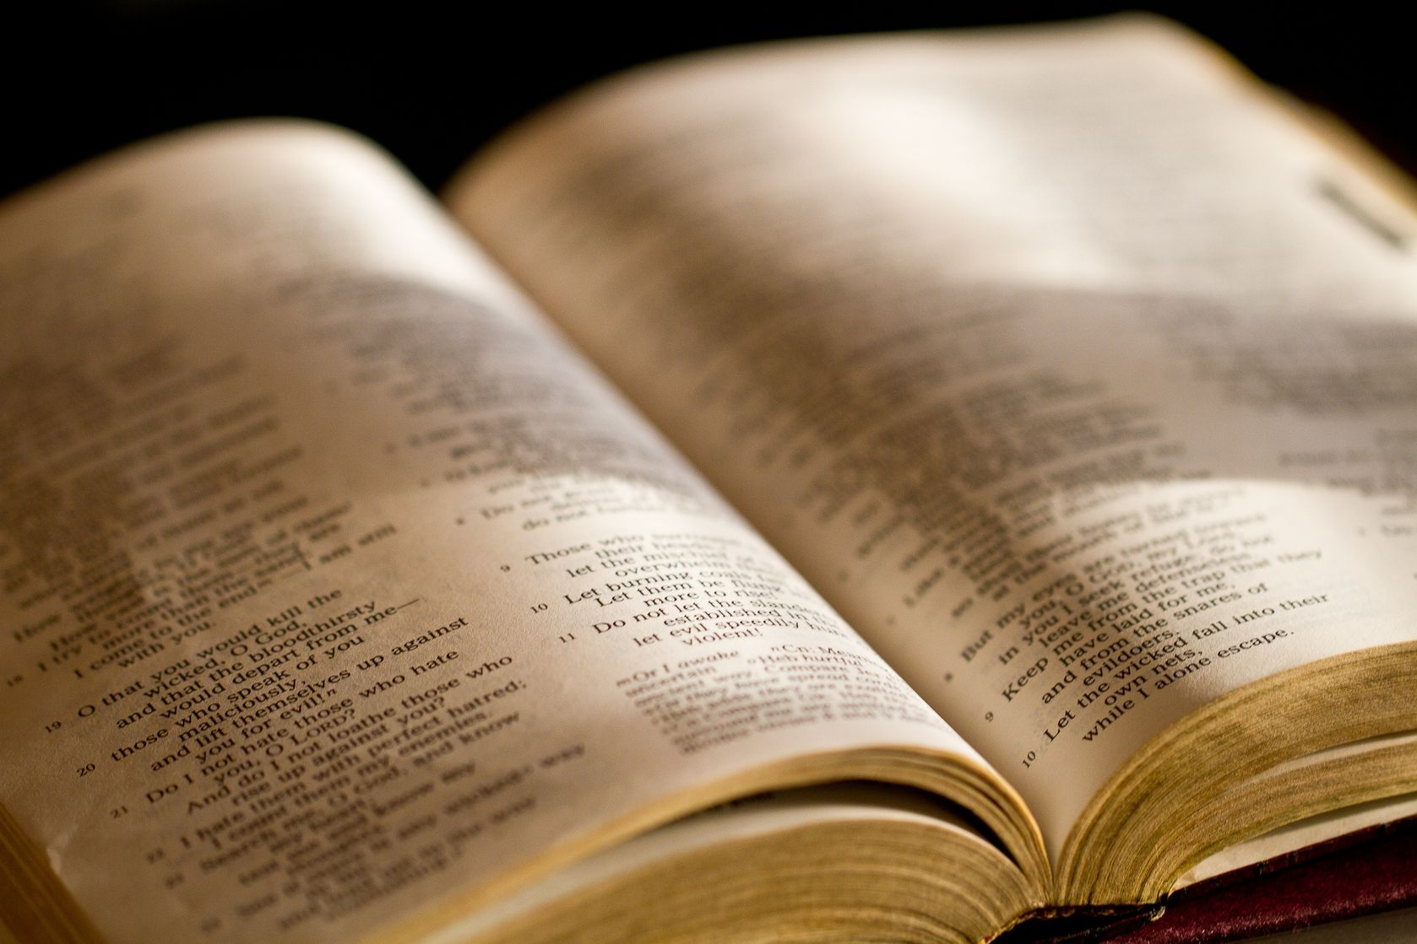
Psa 73:1 - A Psalm of Asaph. God is good to Israel, To such as are pure in heart.

Slide 7
Psa 73:2 - But as for me, my feet had almost stumbled; My steps had nearly slipped.

Slide 8
Psa 73:3 - For I was envious of the boastful, When I saw the prosperity of the wicked.

Slide 9
Psa 73:4 - For there are no pangs in their death, But their strength is firm.

Slide 10
Psa 73:5 - They are not in trouble as other men, Nor are they plagued like other men.

Slide 11
Psa 73:6 - Therefore pride serves as their necklace; Violence covers them like a garment.

Slide 12
Psa 73:7 - Their eyes bulge with abundance; They have more than heart could wish.

Slide 13
Psa 73:8 - They scoff and speak wickedly concerning oppression; They speak loftily.

Slide 14
Psa 73:9 - They set their mouth against the heavens, And their tongue walks through the earth.

Slide 15
Psa 73:10 - Therefore his people return here, And waters of a full cup are drained by them.

Slide 16
Psa 73:11 - And they say, "How does God know? And is there knowledge in the Most High?"

Slide 17
Psa 73:12 - Behold, these are the ungodly, Who are always at ease; They increase in riches.

Slide 18
Psa 73:13 - Surely I have cleansed my heart in vain, And washed my hands in innocence.

Slide 19
Psa 73:14 - For all day long I have been plagued, And chastened every morning.

Slide 20
Psa 73:15 - If I had said, "I will speak thus," Behold, I would have been untrue to the generation of Your children.

Slide 21
P Psa 73:16 - When I thought how to understand this, It was too painful for me—

Slide 22
Do you ever feel that way that Asaph felt?

Slide 23
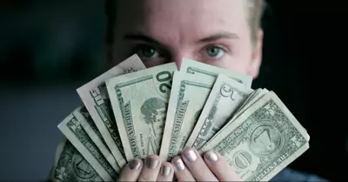
How did he feel about the wicked?
They are prospering but I am not…
They are strong, even in death…
They are proud…
They are violent…
They have so much material wealth…
They laugh and make fun of the righteous…
They are at ease and are rich…
They say that God does not know…

Slide 24
How did he feel about himself?
I have cleansed myself for nothing…
I am troubled and disciplined every day…
This is too painful for me!!!

Slide 25
What changed his mind?

Slide 26
God changed his focus!

Slide 27
Psa 73:17 - Until I went into the sanctuary of God; Then I understood their end.
Notes:
I

Slide 28
Psa 73:18 - Surely You set them in slippery places; You cast them down to destruction.
Notes:
I

Slide 29
Psa 73:19 - Oh, how they are brought to desolation, as in a moment! They are utterly consumed with terrors.
Notes:
I

Slide 30
Good news: God is a righteous and fair judge!

Slide 31
Most people do not live with the understanding that God will judge and reward both the wicked and the good, but it is true!

Slide 32
Gal 6:7 - Do not be deceived, God is not mocked; for whatever a man sows, that he will also reap.

Slide 33
Gal 6:8 - For he who sows to his flesh will of the flesh reap corruption, but he who sows to the Spirit will of the Spirit reap everlasting life.

Slide 34
Gal 6:9 - And let us not grow weary while doing good, for in due season we shall reap if we do not lose heart.

Slide 35
Don’t be fooled/deceived:
By false prophets
By deceiving spirits
By those who seem to “get away with it”
By your own desires
Don’t deceive yourself, and don’t allow yourself to be deceived by others.

Slide 36
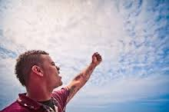
God is not mocked:
You cannot imitate or pretend with Him!
You cannot make fun of Him and get away with it!
You cannot fool Him!
He knows what is in your heart and will deal with you accordingly!

Slide 37
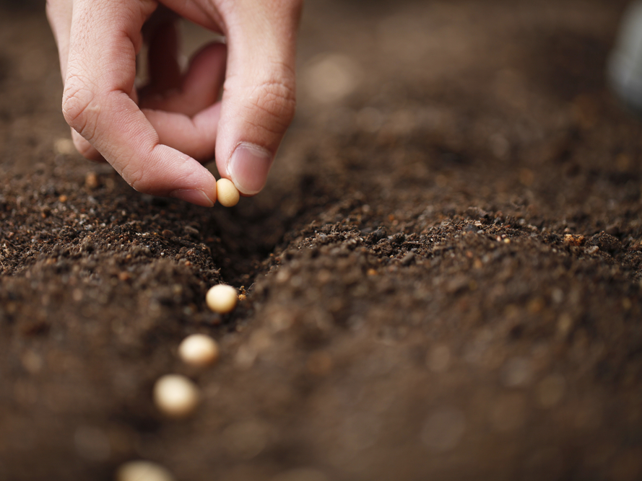
There is a law of sowing and reaping:
If you sow to your flesh (living for the cravings of your sinful nature) you will reap corruption (physical and moral decay and ruin)
If you sow to the Spirit (keeping in step with the Spirit of God) you will reap everlasting life

Slide 38
So don’t get tired of doing good, for at the proper time you will reap the benefits of your works if you don’t give up!

Slide 39
1Co 15:58 - Therefore, my beloved brethren, be steadfast, immovable, always abounding in the work of the Lord, knowing that your labor is not in vain in the Lord.
Notes:
As we end the year and look to the New Year, we can be encouraged by the fact that God will reward us for our works, both in this life and in the life to come. Keep doing good! Your labor is not in vain!

